Slide 1
Solved Numericals
Woodward Fieser Rule
to calculate the
wavelength of maximum
Absorption for conjugated dienes
Dr Ekta Khosla

Slide 2
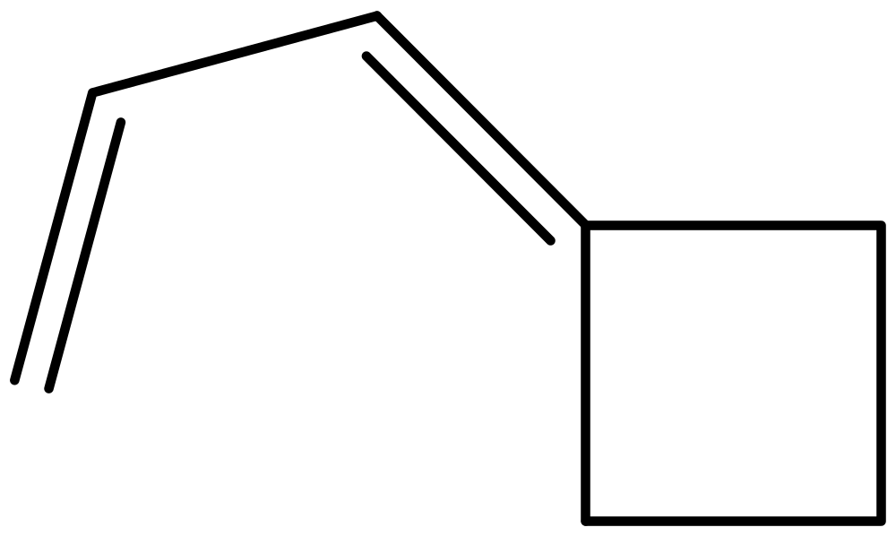
1.

Slide 3
Calculation:
Acyclic diene=214nm
Exocyclic double bond =5nm
Ring Residue=2*5=10nm
Total= 232nm

Slide 4
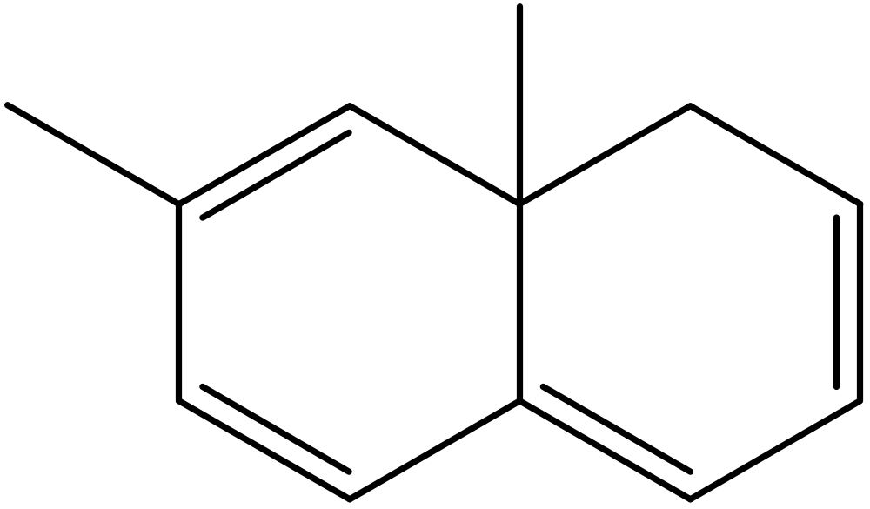
2.

Slide 5
Calculation:
Homoannular diene=253nm
Ring Residue or methyl group=4*5=10nm
Exocyclic double bond=5nm
Extention of conjugation=
2*30=60nm
Total=328nm

Slide 6
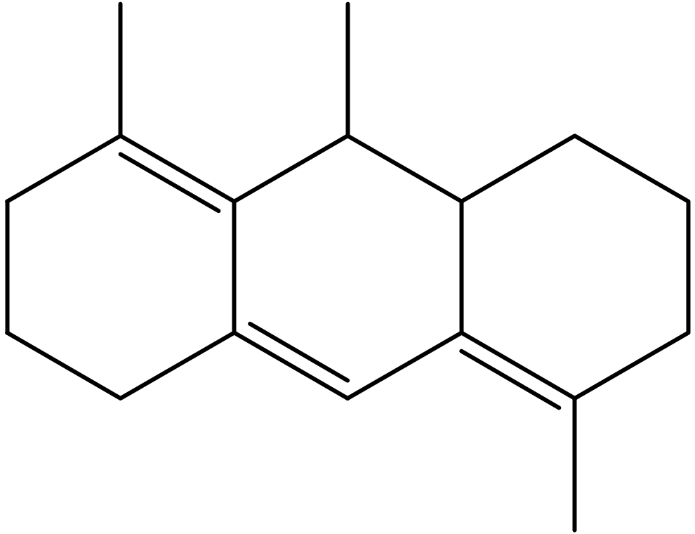
3.

Slide 7
Calculation:
Hetroannular diene=214nm
Extension of double bond=30nm
Ring residue=7*5=35nm
Exocyclic double bond=3*5=15nm
Total=294nm

Slide 8
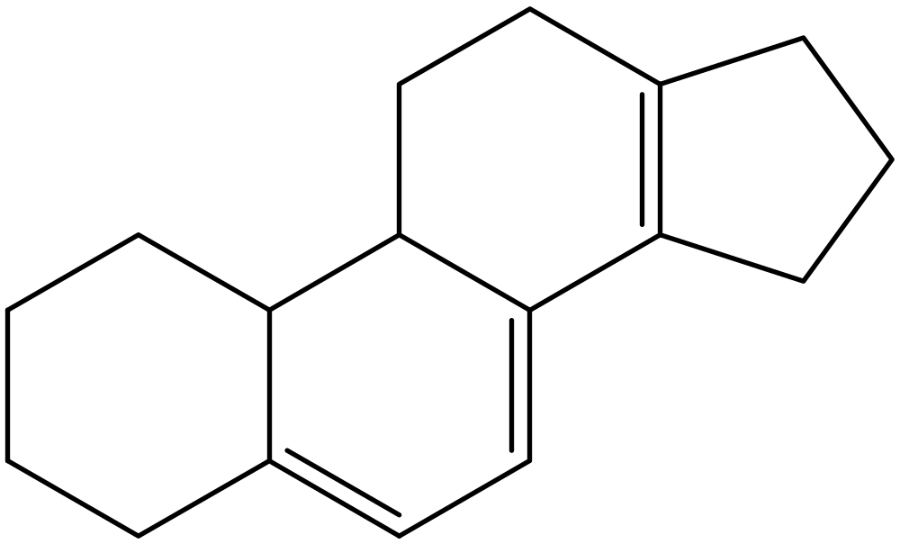
4.

Slide 9
Calculation:
Homoannular diene=253nm
Extention of conjugated diene=30nm
Exocyclic double bond=2*5=10nm
Ring residue=6*5=30nm
Total=323nm

Slide 10
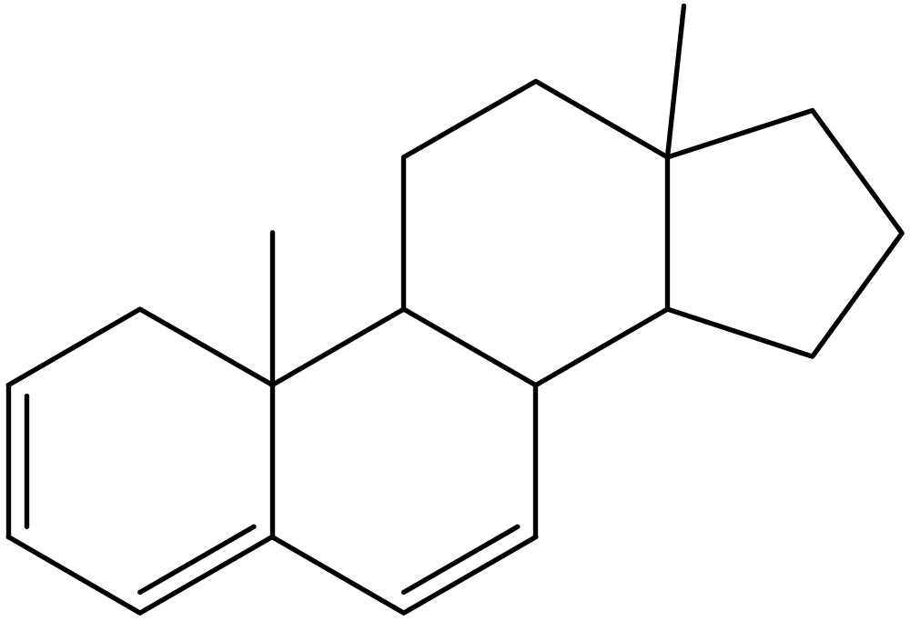
5.

Slide 11
Calculation:
Homoannular diene=253nm
Extention of conjugation=30nm
Ring Residue=3*5=15nm
Exocyclic double bond=5nm
Total=303nm

Slide 12
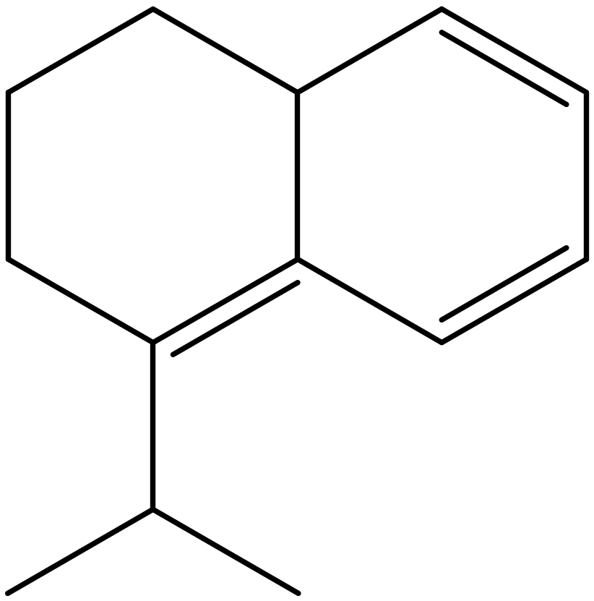
6.

Slide 13
Calculation:
Homoannular diene=253nm
Extention of conjugation=30nm
Exocyclic double bond=5nm
Ring Residue=4*5=20nm
Total=308nm

Slide 14
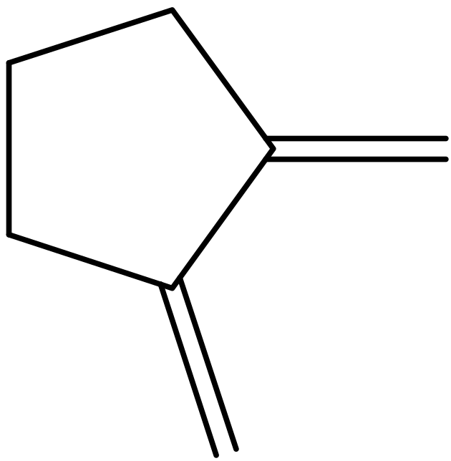
7.

Slide 15
Calculation:
Acyclic diene=217nm
Ring Residue=2*5=10nm
Exocyclic double bond=2*5=30nm
Total=237nm

Slide 16
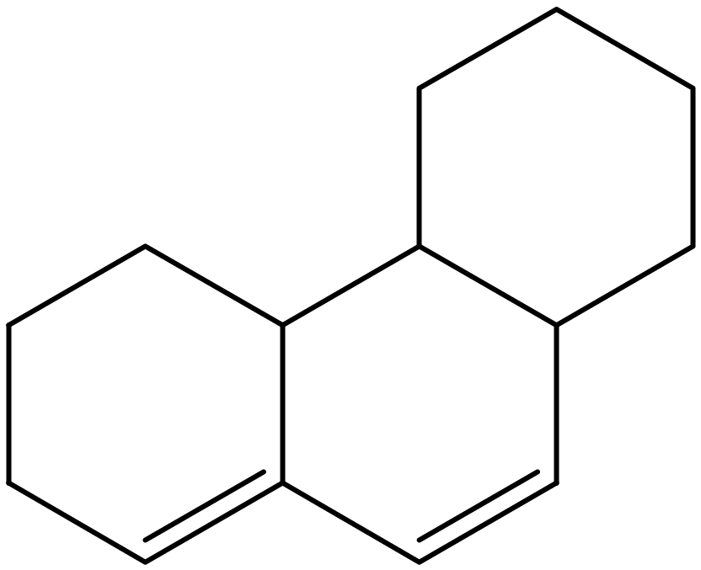
8.

Slide 17
Calculation:
Hetroannular diene=214nm
Exocyclic double bond=5nm
Total=219nm

Slide 18
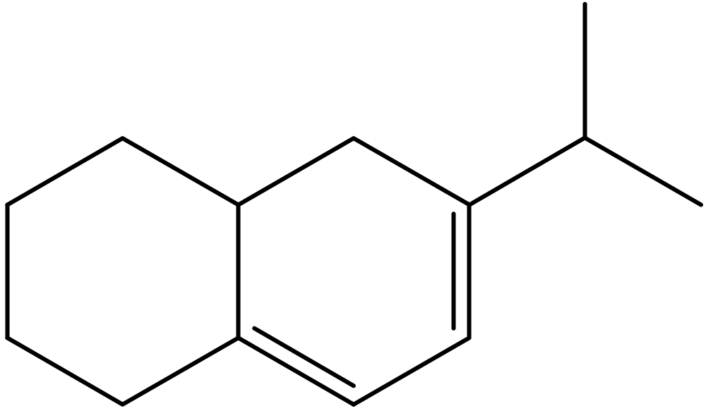
9.

Slide 19
Calculation:
Homoannular diene=253nm
Exocyclic double bond=5nm
Ring Residue=4*5=20nm
Total=278nm

Slide 20
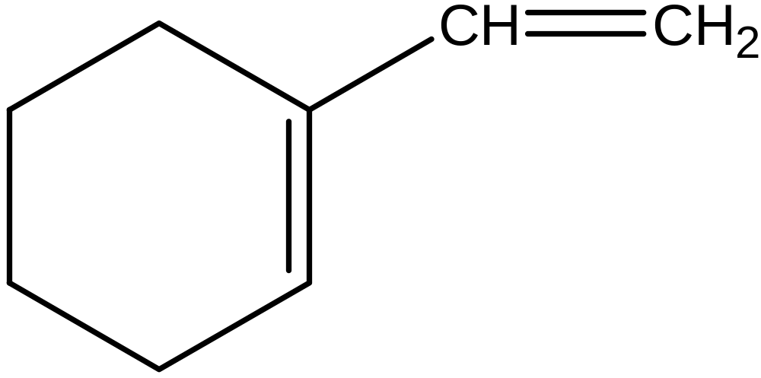
10.

Slide 21
Calculation:
Acyclic double bond=217nm
Exocyclic bond=5nm
Ring Residue=2*5=10nm
Total=232nm

Slide 22
Thank You

