Slide 1
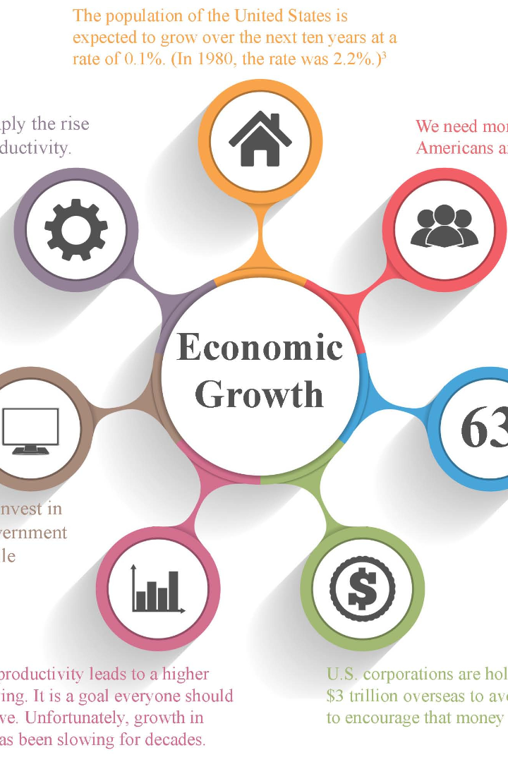


HARROD DOMAR MODEL
The Harrod-Domar model is a concept in economics that explains the relationship between savings and economic growth. In this presentation, we will dive into the key variables, assumptions, limitations, and applications of this model.
by Dr. Meenakshi Duggal

Slide 2

Concept of Economic Growth
Economic growth refers to the increase in the production and consumption of goods and services in an economy over time. It is essential for improving the standard of living and reducing poverty. Understanding the factors that drive economic growth is crucial for policymakers and economists.

Slide 3

Harrod-Domar Model in Brief
The Harrod-Domar model proposes that economic growth depends on investment. According to the model, higher levels of investment contribute to increased production capacity, which leads to economic growth. This model highlights the significance of capital accumulation for stimulating economic development.

Slide 4

Assumptions of the Harrod-Domar Model
The Harrod-Domar model is based on several assumptions, including constant capital-output ratio, fixed saving rate, and no technological progress. These assumptions simplify the analysis and provide a framework for understanding the relationship between investment and economic growth.

Slide 5

Key Variables in the Harrod-Domar Model
Investment
Savings
Multiplier Effect
Represents the amount of capital expenditure in the economy. Higher investment levels contribute to increased production capacity and potential economic growth.
Refers to the portion of income that individuals, businesses, and the government save instead of consuming. Savings are necessary to finance investment and drive economic growth.
Describes the phenomenon where a change in investment leads to a greater change in national income. It highlights the magnifying impact of investment on economic growth.

Slide 6
The Power of Savings in Fueling Economic Growth
"Savings are the lifeblood of economic growth."
- John Maynard Keynes
According to the Harrod-Domar model, savings hold the key to unlocking sustained economic growth. By increasing savings rates, we can generate the investment needed for expanding production capacity and boosting output. This virtuous cycle fuels the engine of economic development and prosperity. Let's harness the power of savings to drive our economy forward!

Slide 7
Constraints of the Harrod-Domar Model
1
Oversimplified Assumptions
2
Investment Dependency
3
External Factors
The model does not account for external factors such as trade dynamics, exchange rates, and global economic conditions, which can significantly impact a country's growth trajectory.
The Harrod-Domar model relies on simplifying assumptions that may not fully capture the complexity of real-world economies. Factors such as technological progress, human capital, and institutional quality are not considered in this model.
As the Harrod-Domar model emphasizes the role of investment in economic growth, it implies a degree of dependency on the availability of investment funds. In the absence of sufficient investments, economic growth may be constrained.

Slide 8

Applications and Criticisms of the Harrod-Domar Model
1
Applications
The Harrod-Domar model has been used by policymakers and economists to develop strategies for promoting economic growth, especially in developing countries. It has shaped investment policies, aid programs, and development plans worldwide.
2
Criticisms
Despite its contributions, the Harrod-Domar model has received criticism. Some argue that it oversimplifies the complexities of economic growth and neglects the importance of factors like innovation, human capital, and entrepreneurship. Others contend that its assumptions may not hold in real-world scenarios.

