Slide 1

In-Groups and Out-Groups
Understanding the complex dynamics of in-groups and out-groups is crucial for fostering a more inclusive and equitable society. This presentation explores the concept of in-groups and out-groups, their formation, the psychology behind them, and strategies to mitigate their potential negative impacts.
by Bhawna K
BK

Slide 2
What are in-groups and out-groups?
In-Group
Out-Group
A group that an individual identifies with and feels a sense of belonging to. Members share common characteristics, values, or beliefs.
A group that an individual does not identify with or feel a sense of belonging to. Members are perceived as different or outside the in-group.

Slide 3
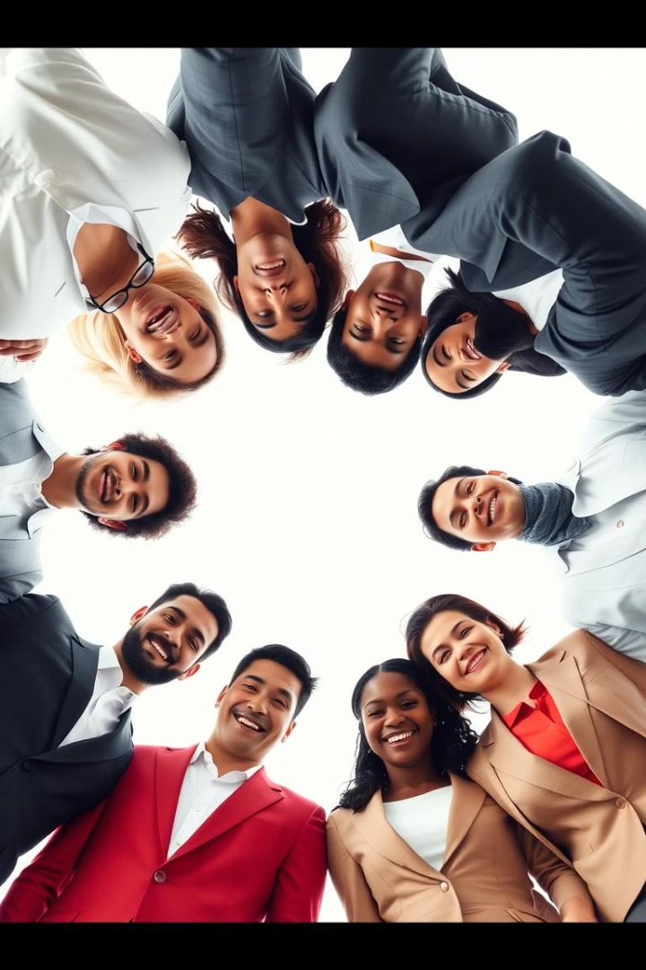
How do we form these groups?
Shared Identity
Socialization
Individuals form in-groups based on common characteristics like ethnicity, religion, gender, or profession.
Early childhood experiences and upbringing shape our understanding of social norms and group affiliation.
Shared Experiences
Experiences like working together on a project or overcoming a challenge can create a sense of shared identity and belonging.

Slide 4




The psychology behind in-group favoritism
1
Positive Stereotypes
2
Increased Trust
3
Enhanced Cooperation
4
Favorable Treatment

Slide 5




Potential consequences of in-group/out-group dynamics
Discrimination
Negative attitudes and behaviors towards out-groups can lead to unfair treatment.
Conflict
Competition and tension between groups can escalate to violence or hostility.
Social Exclusion
Out-groups may be marginalized or excluded from opportunities.

Slide 6




Strategies for reducing in-group bias
Raise Awareness
Promote Interaction
Educate individuals about the nature of in-group bias and its potential consequences.
Encourage contact and collaboration between members of different groups.
Foster Empathy
Help individuals understand the perspectives and experiences of out-groups.

Slide 7
Building a culture of inclusion
1
Diversity
2
Equity
3
Inclusion

Slide 8

The benefits of embracing diversity
1
2
Innovation
Productivity
Diverse perspectives and ideas can lead to more creative solutions.
A more inclusive workplace can improve team performance and efficiency.
3
Reputation
Embracing diversity enhances an organization's image and brand value.

Slide 9

Conclusion: Moving beyond us vs. them
By recognizing and challenging in-group bias, we can create a more equitable and just society. Building a culture of inclusion and embracing diversity are essential steps in fostering a world where everyone feels valued and respected.

