Slide 1
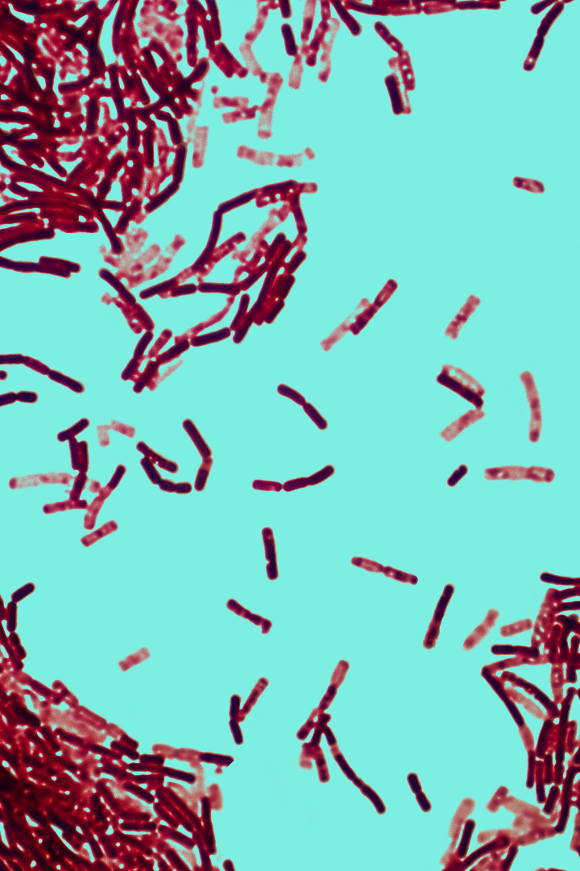


Exploring Bacteriology
Welcome to the fascinating world of bacteriology. Discover the incredible diversity of life on earth by exploring the science of bacteria: their history, structure, reproduction, health applications, and more!
by simran kaur

Slide 2

Introduction
Definition
Bacteriology is the scientific study of bacteria - single-celled microorganisms that are essential to life on Earth.
Importance
Studying bacteriology helps us understand the role of bacteria in the environment, in the human body, and in industry, leading to new applications and discoveries.
History
Ever since the discovery of bacteria by Antonie van Leeuwenhoek in 1676, scientists have been uncovering new information about these complex and fascinating organisms.

Slide 3
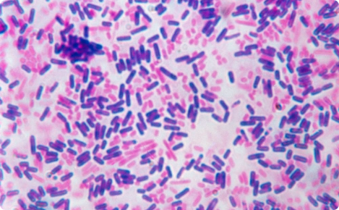
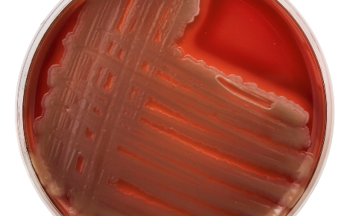
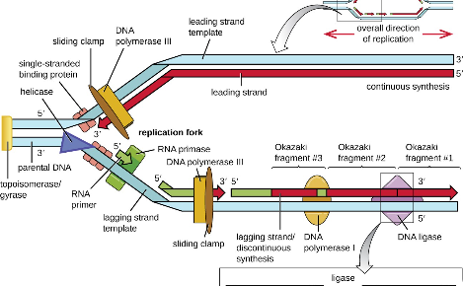
Structure and Characteristics
Basic structure
Classification
Bacteria have a simple, yet powerful structure that allows them to survive in a variety of conditions and adapt to almost any environment.
Bacteria can be classified into different groups based on their shape, arrangement, staining behavior, and other characteristics. This helps us understand their different properties and behaviors.
Reproduction
Bacteria reproduce quickly and efficiently through a variety of methods, including binary fission and conjugation.

Slide 4

Bacterial Growth
1
Process of Growth
Bacteria require all the basic components of life to grow, including nutrients, energy, and a suitable environment. They undergo a four-stage process of growth: lag, log, stationary, and death.
2
Reproduction
Bacteria can reproduce sexually and asexually, depending on their environmental conditions. Binary fission is the most common method of asexual reproduction, where one cell splits into two identical daughter cells.
3
Regulation
Bacterial growth is regulated by various factors such as the pH of the environment, oxygen levels, temperature, and presence of other bacteria.

Slide 5
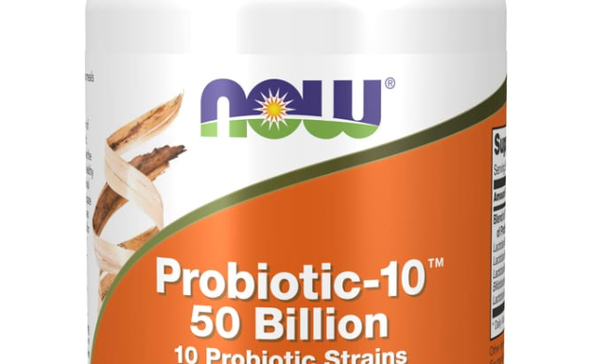
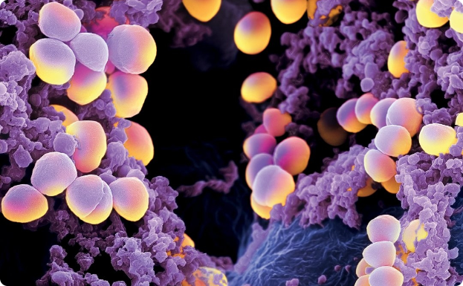
Bacteria in Human Health
Beneficial
Pathogenic
Beneficial bacteria help humans digest food, produce vitamins, and prevent disease. Probiotics are living bacteria that can be found in certain foods, like yogurt or kombucha.
Pathogenic bacteria can cause harm to the human body by releasing toxins, causing infections, or triggering the immune system to release an inflammatory response. Staphylococcus aureus can cause a range of infections, from minor skin infections to life-threatening infections like pneumonia or sepsis.

Slide 6
Applications of Bacteriology
Medical
Industrial
Environmental
Bacteriology has led to the development of antibiotics, vaccines, and other treatments for bacterial diseases. It also plays a role in forensic science, helping to identify potential pathogens in crime scenes.
Bacteria are used in various industrial processes, including fermentation in the production of beer, wine, and cheese. They are also used to clean up hazardous wastes and oil spills.
Understanding bacteria is critical to studying and maintaining ecosystems and the biosphere. Bacteria are essential for sustaining plant growth, breaking down organic matter, and cycling nutrients through the environment.

Slide 7
Conclusion
1
Wrap-Up
Bacteriology plays an important role in our understanding of life on earth and has led to numerous discoveries, applications, and advancements. Continue to learn and explore the fascinating topic of bacteriology!
2
Further Study
Read up on groundbreaking scientists like Louis Pasteur or Robert Koch. Learn more about how bacteria play a role in making antibiotics and vaccines.

