Slide 1

Basics and Types of Oscillators
B. Sc- 5th Sem-Electronics
RR BAWA DAV College For Girls, Batala
Prof. Pankaj Kumar
HOD, Physics

Slide 2
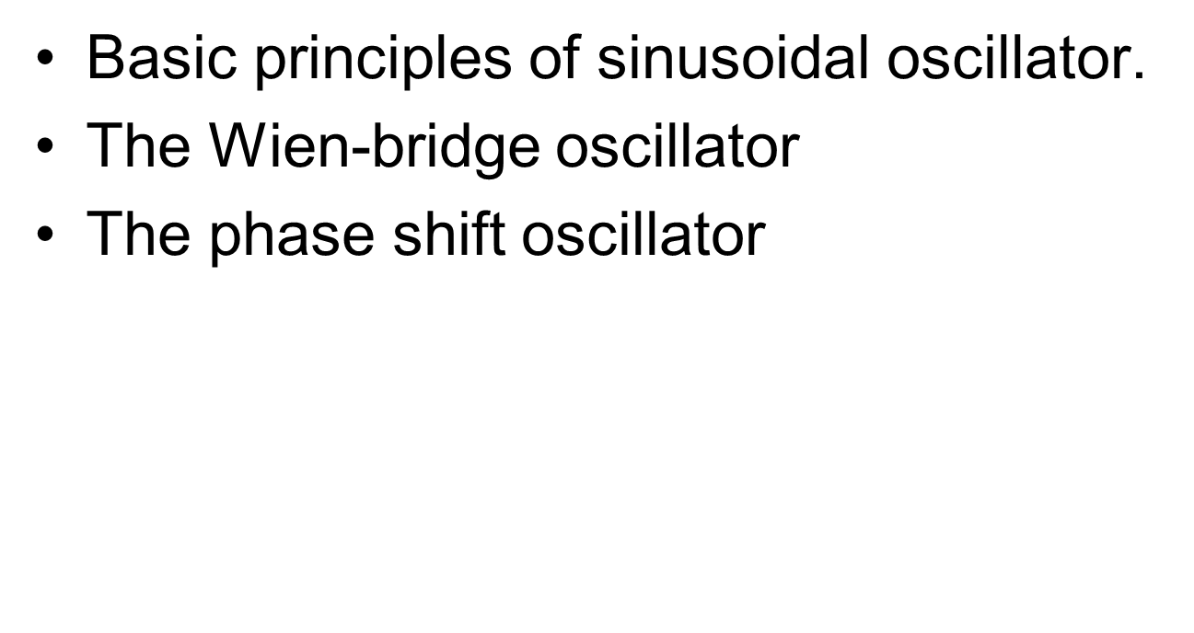
Oscillators

Slide 3
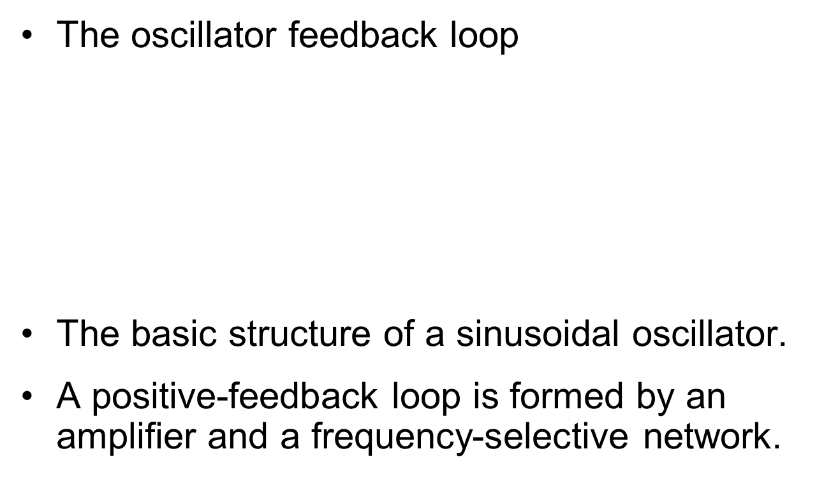
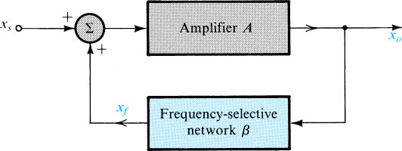

Slide 4
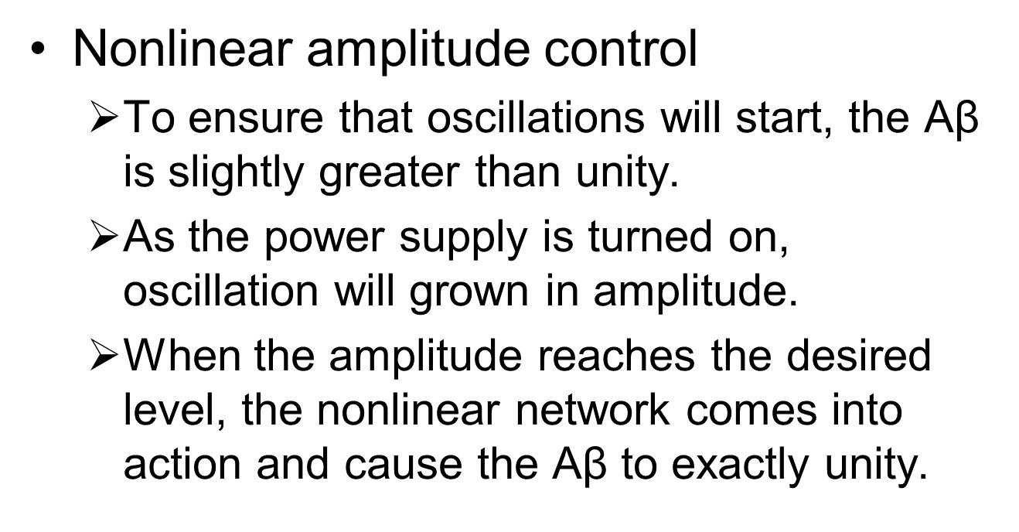
Basic Principles of Sinusoidal Oscillator

Slide 5
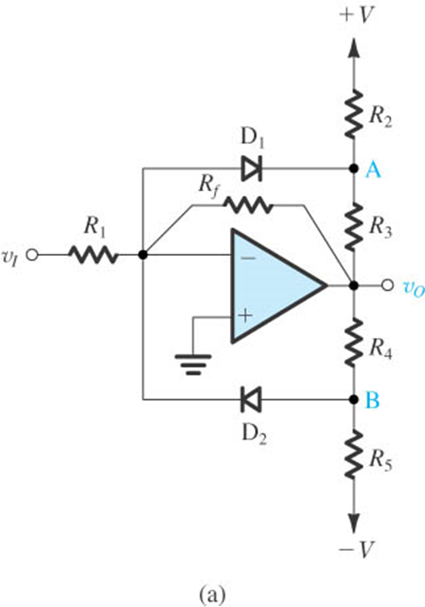
A Popular Limiter Circuit for Amplitude Control

Slide 6
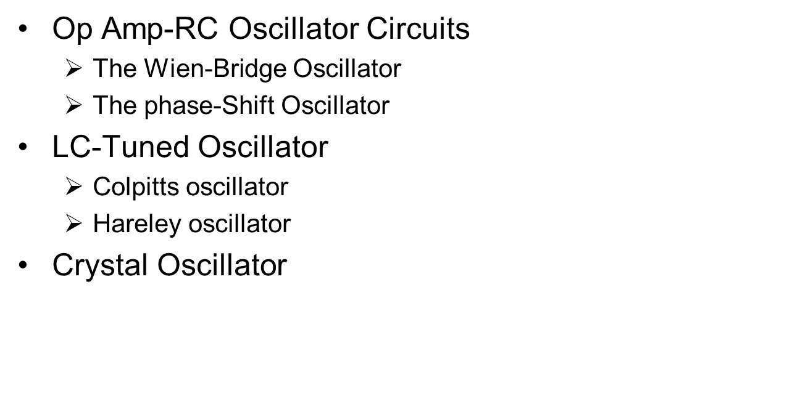
Oscillator Circuits

Slide 7
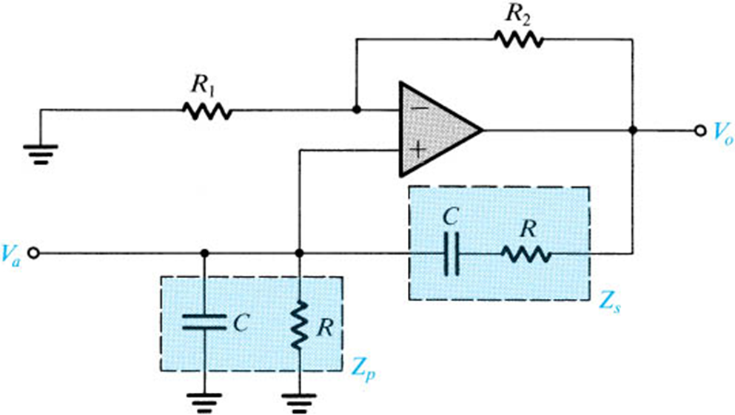
The Wien-Bridge Oscillator
A Wien-bridge oscillator without amplitude stabilization.

Slide 8
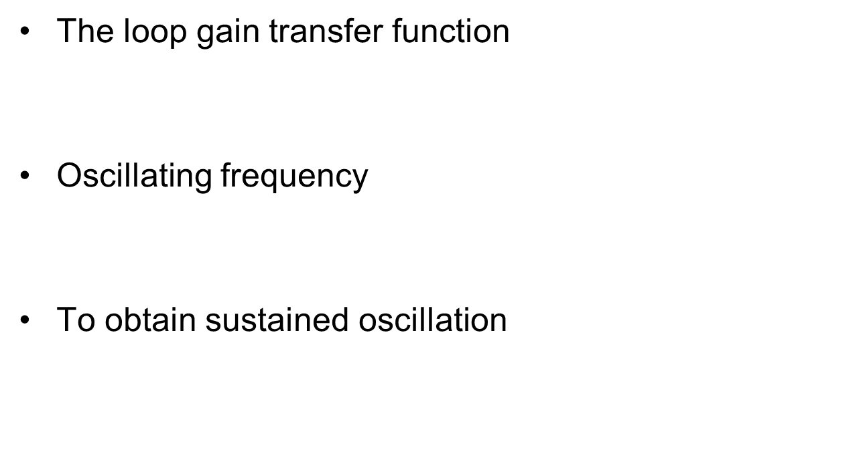
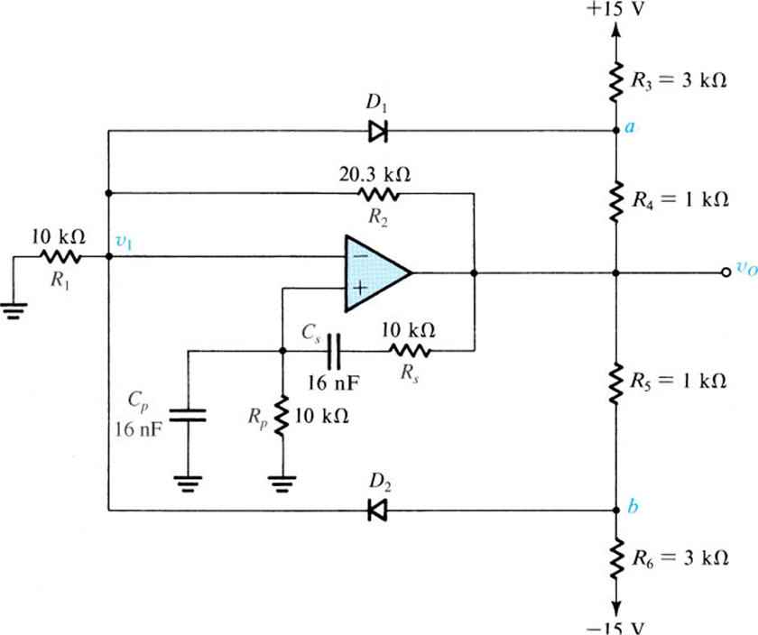
The Wien-Bridge Oscillator
A Wien-bridge oscillator with a limiter used for amplitude control.

Slide 9
Thanks

