Slide 1
Introduction to Carbocations
Carbocations are positively charged carbon-based species that play a crucial role in many organic reactions. These reactive intermediates are key to understanding important mechanisms like nucleophilic substitution, elimination, and rearrangements.

Slide 2

Definition and Structure
Carbocations are organic compounds with a positively charged carbon atom. They can have various structures, including planar, pyramidal, and trigonal bipyramidal geometries, depending on the substituents and the degree of stabilization.

Slide 3

Stability of Carbocations
1
Hyperconjugation
2
Inductive Effects
The stabilization of carbocations through overlapping of the positive charge with adjacent sigma bonds is known as hyperconjugation.
Electron-donating substituents can stabilize carbocations through inductive effects, helping to delocalize the positive charge.
3
Resonance Stabilization
Carbocations can be stabilized by resonance, where the positive charge is distributed across multiple atoms.

Slide 4
Formation of Carbocations
Heterolytic Cleavage
Hydride Abstraction
Rearrangements
Carbocations can form via the heterolytic cleavage of C-X bonds, where X is a leaving group like a halide or a weak base.
Carbocations can also be generated through the abstraction of a hydride (H-) from an alkane or alkyl group by a Lewis acid.
Carbocations can undergo rearrangements, where alkyl groups shift to stabilize the positive charge.

Slide 5
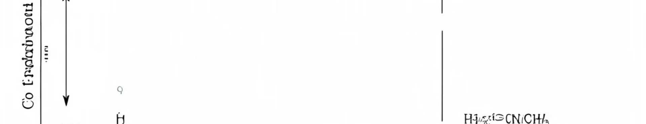
Nucleophilic Substitution Reactions
In nucleophilic substitution reactions, carbocations act as electrophilic reaction intermediates, where a nucleophile attacks the positively charged carbon to displace a leaving group and form a new product.

Slide 6

Elimination Reactions
Stereochemistry
E1 Mechanism
The stereochemistry of the alkene product in elimination reactions is determined by the mechanism and the stability of the carbocation intermediate.
In the E1 mechanism, a carbocation intermediate is formed, followed by the elimination of a leaving group to create an alkene.
1
2
3
E2 Mechanism
The E2 mechanism involves the concerted elimination of a leaving group and a hydrogen atom, forming an alkene without a carbocation intermediate.

Slide 7





Rearrangement Reactions
Alkyl Shifts
Hydride Shifts
Alkyl groups can shift to stabilize a carbocation, forming a more stable rearranged carbocation.
Hydride shifts can also occur, where a hydrogen atom moves from one carbon to another to stabilize a carbocation.
Ring Expansions
Fragmentation
Carbocations can undergo ring expansions, where a ring is enlarged through the migration of a sigma bond.
Carbocations can also undergo fragmentation reactions, where the molecule breaks apart to form more stable products.

Slide 8

Carbocation Intermediates
Primary Carbocations
Least stable
Secondary Carbocations
More stable than primary
Tertiary Carbocations
Most stable
Benzylic Carbocations
Stabilized by resonance with aromatic ring
Allylic Carbocations
Stabilized by delocalization of charge

Slide 9




Importance in Organic Chemistry
Nucleophilic Substitutions
Carbocations are key intermediates in SN1 and SN2 reactions, enabling the displacement of leaving groups.
Elimination Reactions
Carbocations play a crucial role in E1 and E2 elimination mechanisms, leading to the formation of alkenes.
Rearrangements
Carbocation intermediates can undergo various rearrangements, allowing for the synthesis of complex organic compounds.

Slide 10
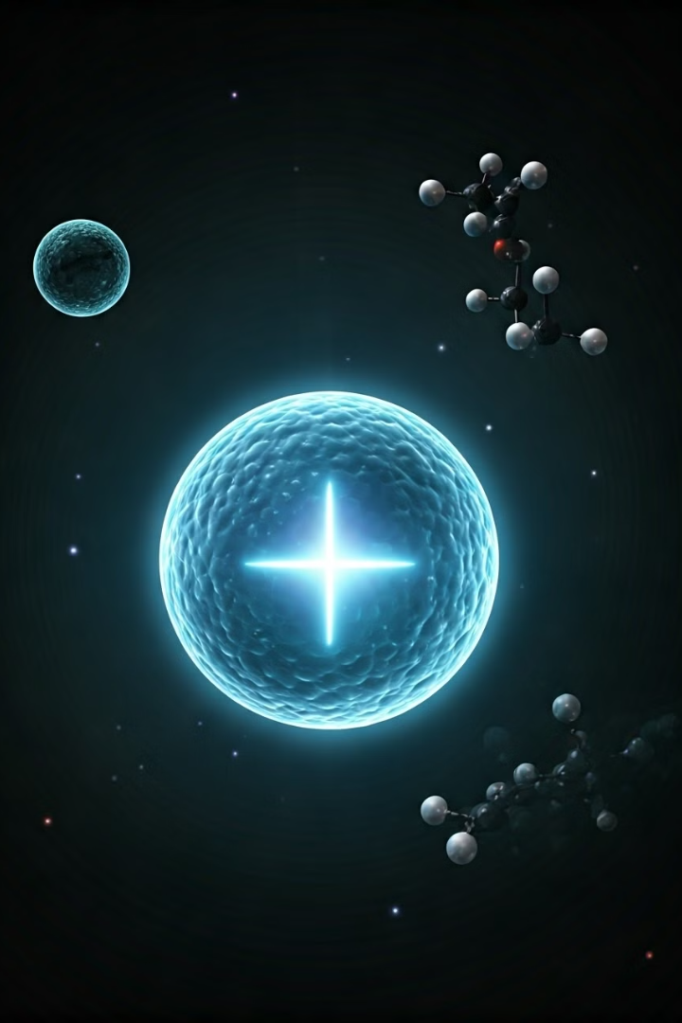
Conclusion and Summary
Carbocations are versatile reaction intermediates that are essential to understanding many fundamental organic chemistry mechanisms. Their stability, formation, and reactivity are crucial concepts for chemists to master, as they enable the synthesis of diverse and complex organic compounds.

