Slide 1

Terrorism in India: A Persistent Challenge
Terrorism remains a critical issue in India, impacting its security, economy, and social fabric. This presentation explores the historical context, evolving trends, and ongoing efforts to address this complex challenge.
BK
by Bhawna K

Slide 2
Historical Context: The Rise of Terrorist Groups
Early Roots
Post-Independence Era
Terrorism in India traces its origins back to the pre-independence era. Groups like the "Ghadar Movement" and the "Hindu Mahasabha" employed violent tactics against British rule.
Following independence, separatist movements in Kashmir, Naxalite insurgency, and the emergence of Islamist militant groups intensified the threat of terrorism.

Slide 3
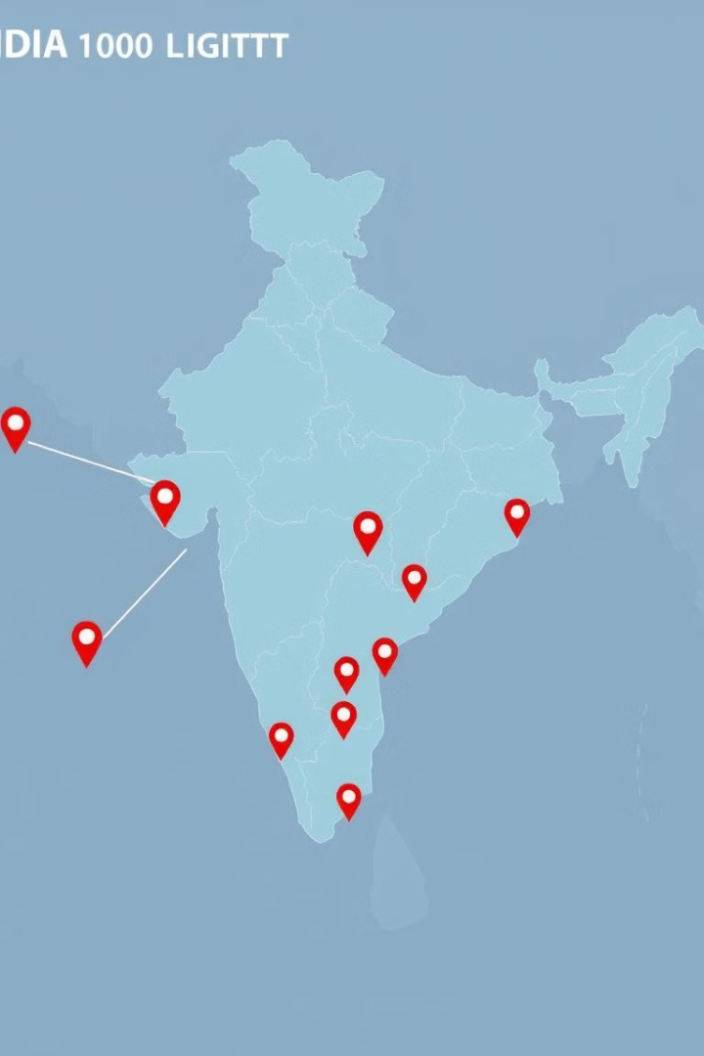
Regions Affected by Terrorism in India
Jammu and Kashmir
Northeastern States
The Kashmir Valley has been a focal point of separatist violence for decades, with groups like the Lashkar-e-Taiba and Jaish-e-Mohammed operating in the region.
Insurgent groups in the northeastern states, driven by ethnic and separatist agendas, have engaged in violent activities, posing a security challenge.
Left-Wing Extremism
Naxalite groups operating in central and eastern India have been responsible for attacks targeting security forces, infrastructure, and civilians.

Slide 4




Tactics and Targets of Terrorist Attacks
Bombings
Shootings
Bombings have been the most common tactic, targeting public spaces, government institutions, and security forces.
Shootouts and attacks on security personnel have become increasingly frequent, particularly in Jammu and Kashmir.
Explosives
Improvised explosive devices (IEDs) have been used extensively, targeting vehicles, public gatherings, and infrastructure.

Slide 5
India's Counterterrorism Efforts
Security Measures
1
Enhanced security measures at public places, airports, and sensitive installations have been implemented.
Intelligence Gathering
2
Intelligence gathering and sharing among agencies have become critical for preempting attacks.
Counter-Insurgency Operations
3
Security forces have been conducting counter-insurgency operations, targeting terrorist hideouts and training camps.

Slide 6



International Cooperation in Fighting Terrorism
Information Sharing
1
Sharing intelligence and best practices among nations is crucial for coordinated action.
Joint Operations
2
Collaborative efforts between countries have been essential in disrupting terrorist networks and training.
Diplomatic Engagement
3
Diplomatic efforts aim to address the underlying causes of terrorism and promote international cooperation.

Slide 7
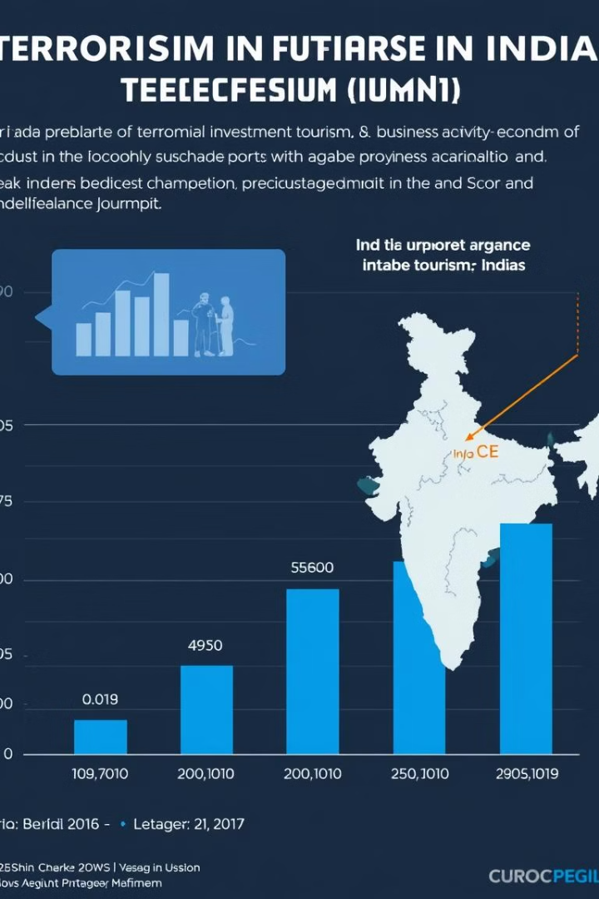
The Impact of Terrorism on India's Economy and Society
50B
2M
Economic Loss
Displacement
Terrorist attacks have resulted in significant economic losses, impacting tourism, infrastructure, and business activity.
Thousands of people have been displaced from their homes due to violence and fear.

Slide 8





Strategies for Strengthening Domestic Security
Strengthening Law Enforcement
Modernizing law enforcement agencies, enhancing their capacity, and equipping them with advanced technology.
Border Security
Improving border security measures to prevent infiltration and cross-border movement of terrorists.
Community Engagement
Building trust and collaboration with communities to counter radicalization and extremism.
Addressing Root Causes
Addressing socioeconomic inequalities, promoting inclusive development, and fostering interfaith harmony.

