Slide 1


Slide 2

Introduction to Buddhism
  A 2500 year old tradition that begins in India and spread and diversified throughout the Far East
  Based on the teachings of the Buddha

Slide 3
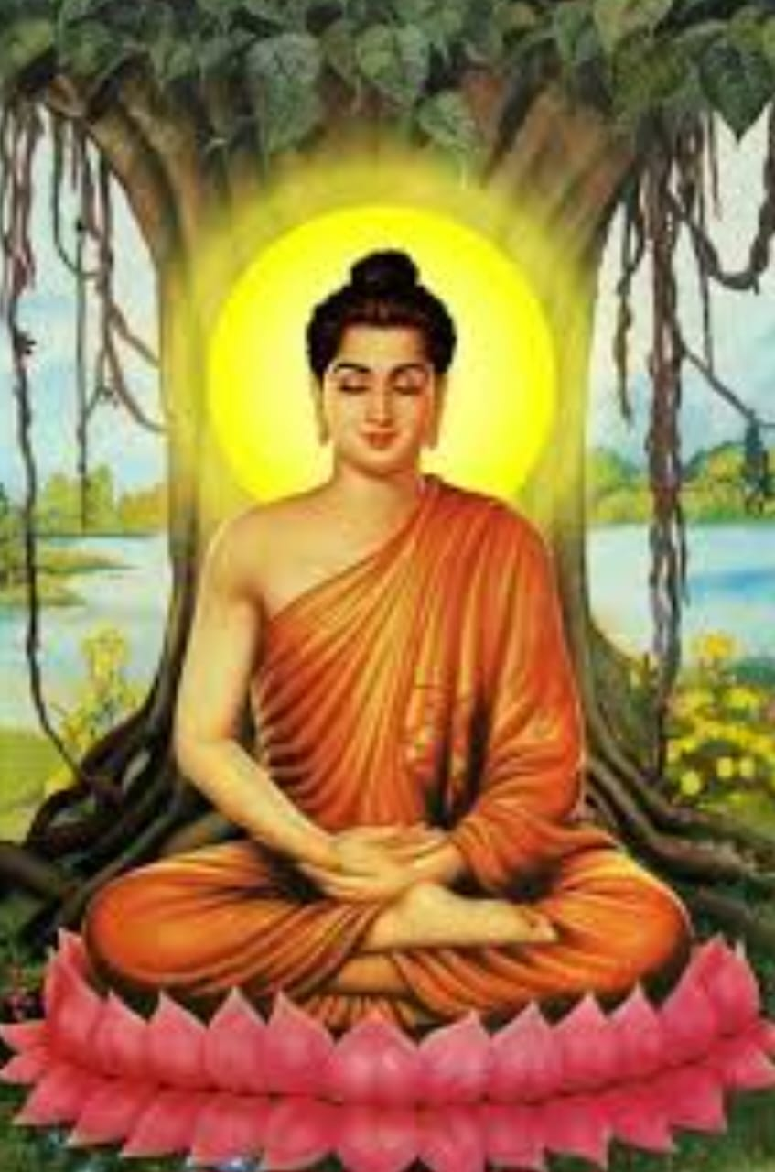
Who was the Buddha?
Siddhartha Gautama was the founder of Buddhism.
Born in 563 B.C.E.in noble caste of India.
Raised in great luxury to be a king.
Empathy for the suffering of the others .
At the age 29 rejected the life of luxury to seek enlightenment and the solution to suffering.
Followed a strict ascetic lifestyle for six years.
Rejected this extreme ,sat in meditation ,achieved Nirvana-an awakening to the truth about life,becoming a Buddha the “Awakened One”at the age of 33.

Slide 4
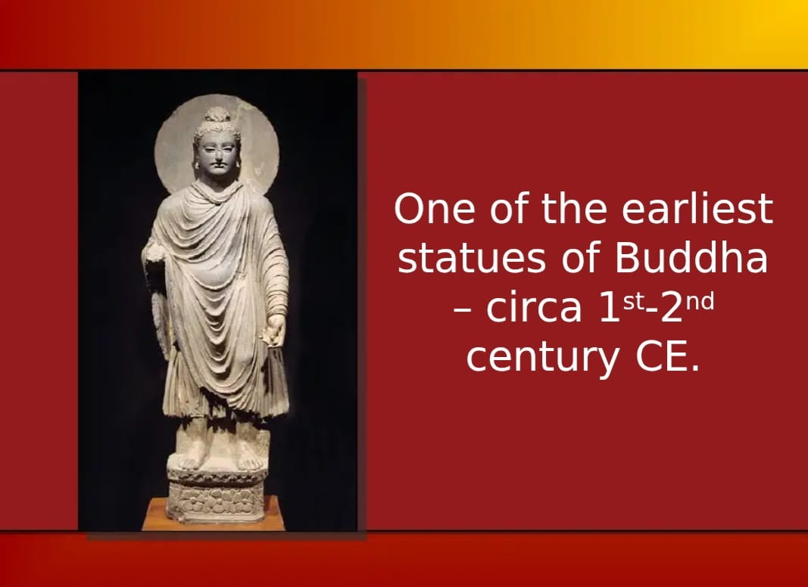

Slide 5
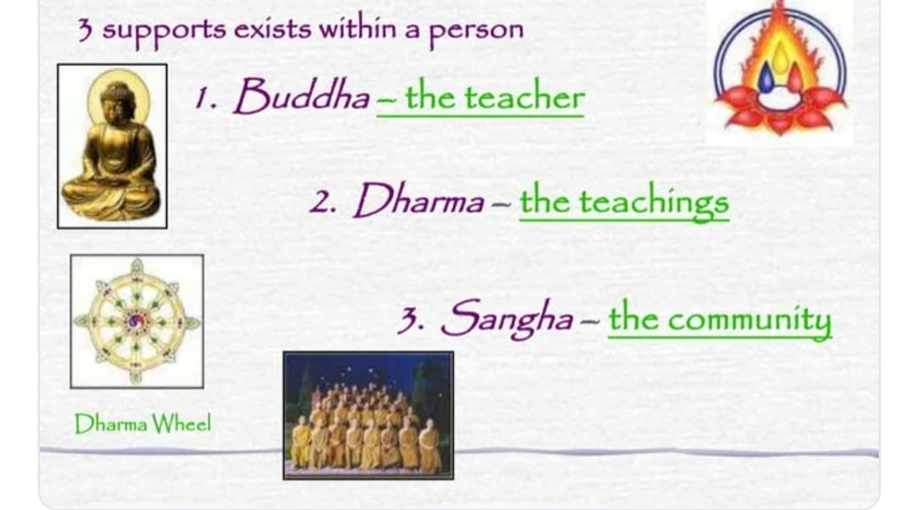
The ‘Three Jewels” of Buddhism

Slide 6
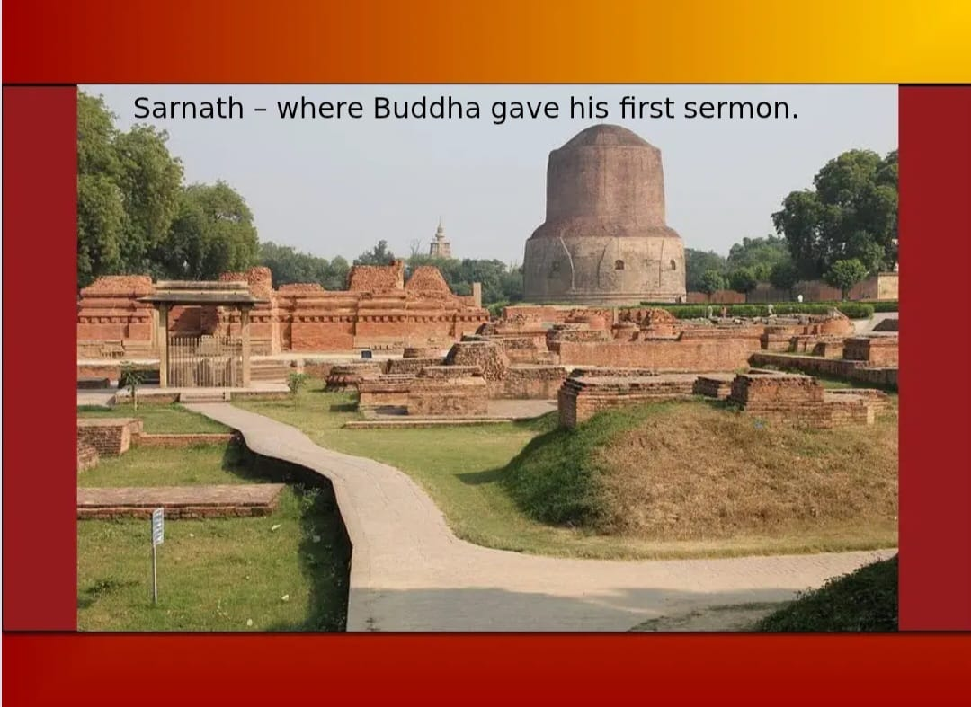

Slide 7
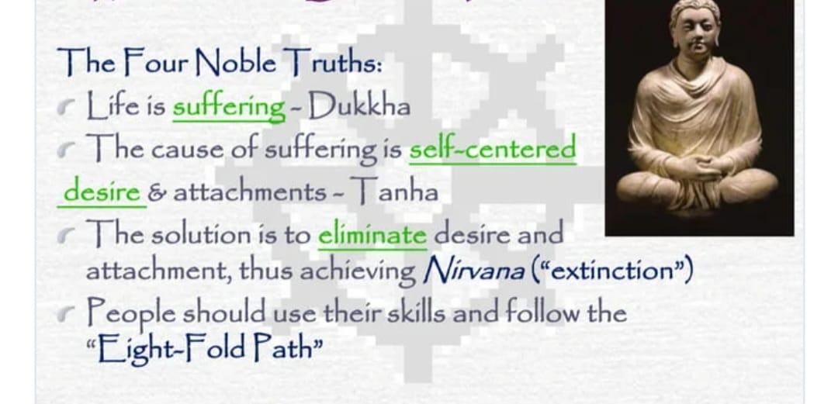
What did Buddha Teach ?

Slide 8
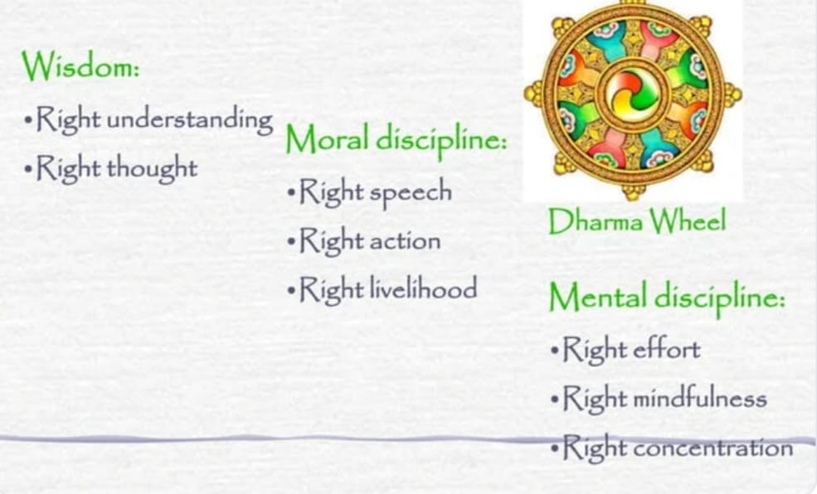
What is the Eight Fold Path?

Slide 9
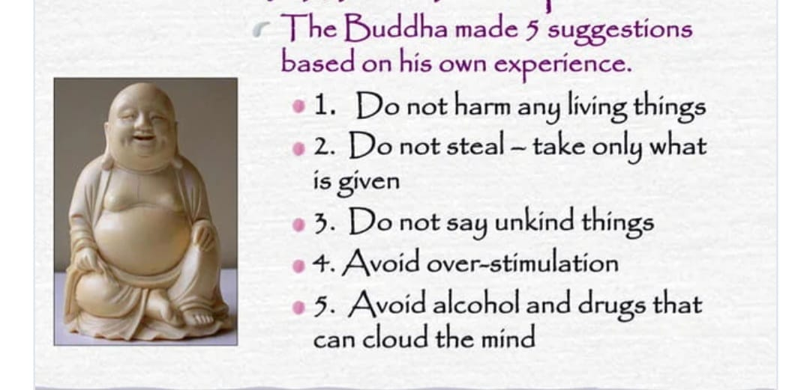
Teachings of the Buddha 5 Moral Precept

Slide 10
THANK YOU

