Slide 1


Caste vs. Class: Understanding the Difference in India
This presentation will explore the differences between caste and class in India, highlighting their historical context, definitions, and impact on society.
by bhawna k

Slide 2
Historical Roots of the Caste System
Ancient Origins
Varna System
The caste system emerged from ancient Hindu scriptures, dividing society into rigid hierarchical groups based on birth.
The four main varnas - Brahmins, Kshatriyas, Vaishyas, and Shudras - defined social roles, duties, and privileges.

Slide 3
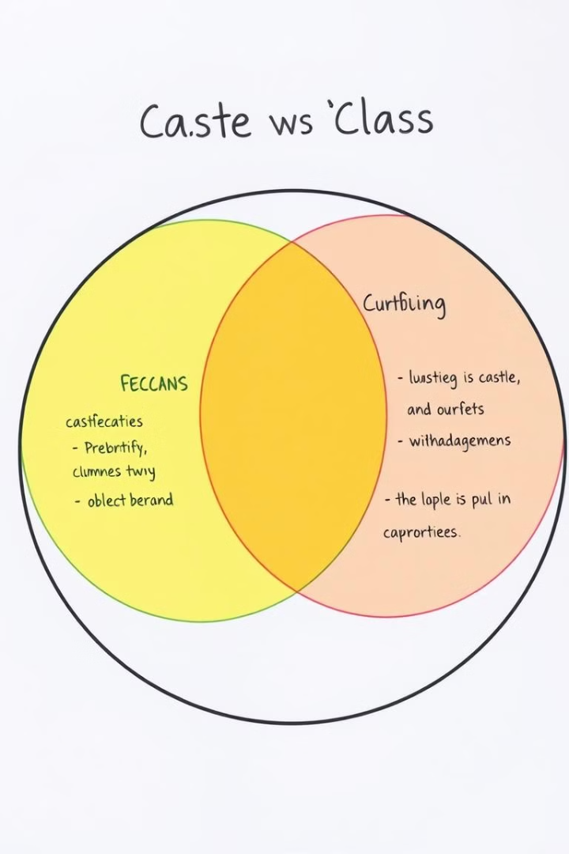
Defining Caste and Class
Caste
Class
A hierarchical system based on birth, determining social status, occupation, and access to resources, often associated with ritual purity.
A socioeconomic hierarchy based on wealth, income, education, and occupation, which is more fluid and can change over time.

Slide 4



Social Mobility: A Key Difference
Limited Mobility
Caste system: Movement between castes is extremely difficult, often restricted by tradition and social pressure.
Potential for Mobility
Class system: Individuals can move up or down the class ladder through hard work, education, and opportunities.

Slide 5



Interplay of Caste and Class
Intersectionality
Compounding Disadvantage
Caste and class often intersect, creating unique experiences and disadvantages for individuals belonging to both.
Lower castes often experience poverty and limited access to opportunities due to social and economic barriers.

Slide 6
Impact on Opportunities
Limited Access
Unequal Resources
Lower castes face discrimination in education, employment, healthcare, and other essential services, perpetuating a cycle of poverty.
Economic inequality is exacerbated by caste-based discrimination, resulting in a significant gap in wealth and resources between different social groups.

Slide 7
Moving Towards a More Equitable Society
Awareness
1
Raising awareness about the complexities of caste and class is crucial for dismantling discriminatory practices and promoting equality.
Affirmative Action
2
Government policies promoting reservation in education and employment for lower castes are essential for creating opportunities.
Economic Empowerment
3
Investing in education, skill development, and entrepreneurship programs can empower marginalized communities and improve their economic well-being.

