Slide 1
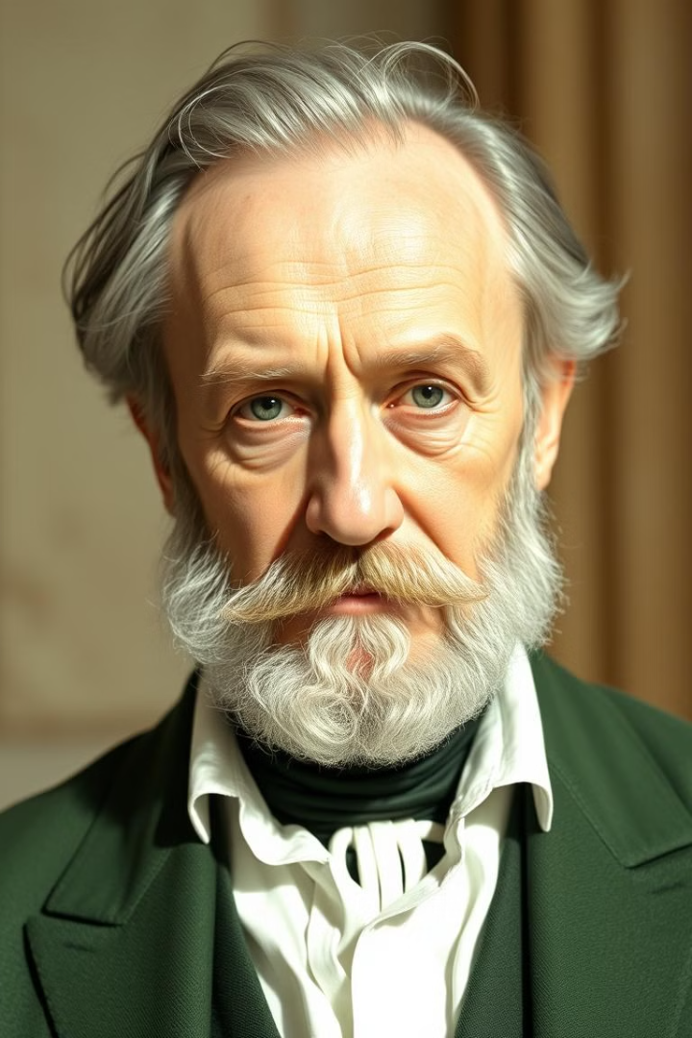
Auguste Comte's Law of Three Stages
The Law of Three Stages is a theory proposed by French philosopher Auguste Comte in the 19th century. It posits that societies evolve through three distinct stages: theological, metaphysical, and positive.
BK
by Bhawna K

Slide 2
What is the Law of Three Stages?
The Law of Three Stages suggests that societies progress through a series of stages. These stages represent different ways of thinking and explaining the world around us.
Comte believed that each stage builds upon the previous one, leading to a more advanced and rational understanding of the world.

Slide 3



The Theological Stage
Supernatural
1
The world is explained through supernatural beings and forces. God, deities, or spirits are believed to control natural phenomena.
Religious Beliefs
2
Religion plays a central role in shaping social life and providing answers to fundamental questions.
Faith-Based
3
Knowledge is based on faith, tradition, and authority. This stage is characterized by dogma and a lack of empirical evidence.

Slide 4
The Metaphysical Stage
Abstract Forces
1
The world is explained through abstract forces and principles like nature, reason, or destiny. These forces are seen as governing human behavior and events.
Philosophical Inquiry
2
Reason and logic begin to play a more prominent role in explaining the world. This stage is characterized by philosophical speculation.
Critical Thinking
3
Individuals begin to question traditional beliefs and look for explanations based on reason and evidence.

Slide 5




The Positive Stage
Empirical Observation
This stage is characterized by scientific observation, experimentation, and the search for objective laws that govern the universe.
Scientific Method
The scientific method becomes the primary way to acquire knowledge. It emphasizes empirical evidence and logical reasoning.
Rational Understanding
The focus shifts from seeking ultimate causes to understanding the relationships between phenomena and predicting future events.

Slide 6

Explanation of the Three Stages
1
The Theological stage is marked by belief in supernatural explanations.
2
In the Metaphysical stage, abstract forces and principles replace supernatural beings.
3
The Positive stage emphasizes scientific observation and experimentation.

Slide 7

Limitations and Criticisms
Oversimplification
Eurocentric Bias
The Law of Three Stages may oversimplify the complex evolution of societies. It fails to account for cultural diversity and historical contingency.
Comte's theory has been criticized for its Eurocentric bias. It assumes that societies progress linearly and that Western societies are more advanced.
Absence of Alternative Stages
It doesn't address the possibility of other stages or societal trajectories beyond the three outlined.

Slide 8




Relevance of the Law of Three Stages Today
Historical Perspective
Critical Thinking
Provides a framework for understanding historical developments and the evolution of thought.
Encourages critical thinking about the ways in which societies explain the world and make decisions.
Social Progress
Raises questions about the nature of social progress and the role of science and reason in shaping societies.

