Slide 1

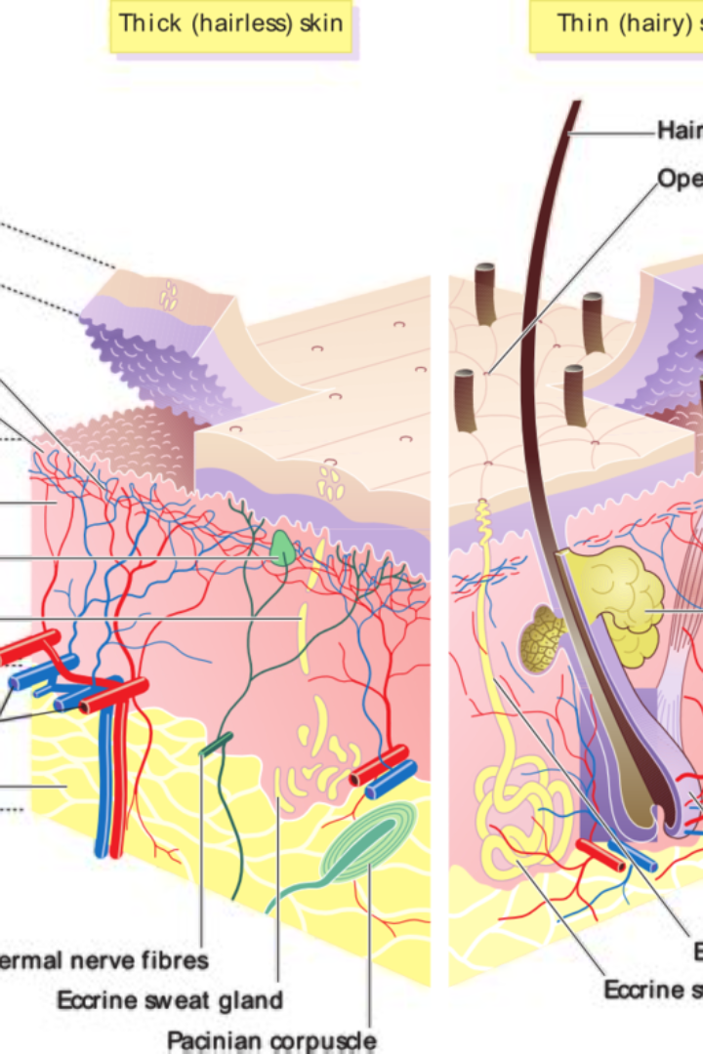


Skin Anatomy
The skin is the largest organ of the body and consists of three main layers: the epidermis, dermis, and hypodermis. Let's explore its functions, disorders, and some essential skin care tips.
by simran kaur

Slide 2

Epidermis
The epidermis is the outermost layer of the skin and acts as a protective barrier against external elements. It contains different types of cells, including melanocytes, which produce the pigment melanin responsible for skin color.

Slide 3

Dermis
1
Structure & Flexibility
2
Accessory Structures
3
Blood Vessels
This layer houses sweat glands, hair follicles, sebaceous glands (oil glands), and sensory receptors, enhancing the skin's functionality.
The dermis contains a rich network of blood vessels, supplying nutrients and oxygen to the skin cells and helping regulate body temperature.
The dermis is located beneath the epidermis and provides structural support to the skin. It contains collagen and elastin fibers, giving the skin its strength, elasticity, and flexibility.

Slide 4

Hypodermis
The hypodermis, also known as subcutaneous tissue, is the deepest layer of the skin. It consists of adipose (fat) tissue that provides insulation, acts as a cushion, and stores energy for the body.

Slide 5
Functions of the Skin
Protection
Sensation
Thermoregulation
The skin acts as a physical barrier, protecting the body against harmful microbes, UV radiation, and mechanical injuries.
The skin contains sensory receptors that allow us to detect touch, pressure, temperature, and pain.
Through sweat production and dilation or constriction of blood vessels, the skin helps regulate body temperature.

Slide 6
Skin Disorders
Acne
Eczema
Psoriasis
A common skin condition characterized by clogged hair follicles and inflammation, resulting in pimples or blackheads.
A chronic inflammatory skin disorder causing itchy, red, and dry patches on the skin.
A chronic autoimmune condition that leads to the rapid buildup of skin cells, causing thick, silvery scales and itchy, dry patches.

Slide 7
Skin Care Tips
1
Protective Sunscreen
Apply broad-spectrum sunscreen with an SPF of at least 30 to shield your skin from harmful UV rays.
2
Gentle Cleansing
Use a mild cleanser to remove dirt and excess oil without stripping away the skin's natural oils.
3
Hydration is Key
Keep your skin hydrated by drinking plenty of water and using moisturizers suitable for your skin type.

Slide 8

Conclusion
Understanding the anatomy of the skin is crucial for maintaining its health and preventing potential skin conditions. By following proper skincare practices and protecting our skin, we can ensure its longevity and well-being.

