Slide 1
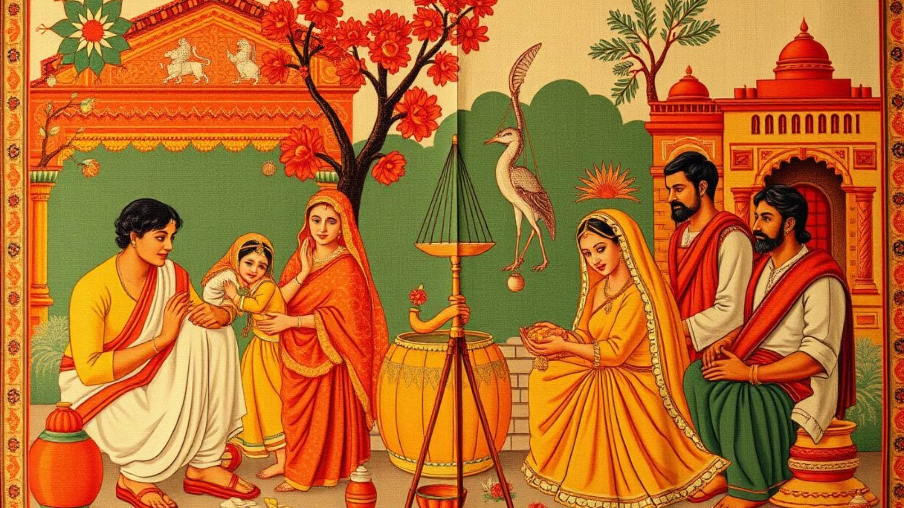

Kinship in India
This document explores the intricate and enduring nature of kinship systems in India. We will delve into the various kinship structures, their impact on social organization, and the role they play in cultural celebrations and daily life. By understanding the dynamics of Indian kinship, we can gain a deeper appreciation for the rich tapestry of Indian society.
by bhawna k

Slide 2
Introduction to Indian Kinship Systems
Kinship in India is a multifaceted concept, encompassing both biological and social ties. It forms the foundation of Indian society, shaping social interactions, inheritance practices, and cultural norms. Indian kinship systems are remarkably diverse, reflecting the country's vast geographical and cultural landscape. From the ancient Vedic period to the modern era, kinship has played a central role in shaping Indian civilization. The concept of *gotra* (patrilineal lineage), for example, has its roots in ancient Vedic texts and continues to hold relevance in contemporary society.
Indian kinship systems are broadly classified into two main categories: patrilineal and matrilineal. While patrilineal systems are more prevalent, matrilineal systems, such as the Nayar community in Kerala, are also significant.

Slide 3
Patrilineal and Matrilineal Kinship Structures
Patrilineal kinship systems trace descent through the male line. In such systems, inheritance, property rights, and social status are passed down from father to son. This is the most common form of kinship in India, observed across various communities, including the Hindus, Sikhs, and Jains. The *gotra* system, which traces ancestry back to a common male ancestor, is an important aspect of patrilineal kinship.
Matrilineal kinship systems, in contrast, trace descent through the female line. In these systems, inheritance and status are passed down from mother to daughter. While less prevalent, matrilineal structures are found among communities like the Nayars of Kerala, the Garos of Meghalaya, and the Khasis of Assam. These systems are characterized by distinct social structures, with the mother's brother often playing a significant role in the lives of his sister's children.

Slide 4
Importance of Clan and Joint Family Systems
Clans, also known as *kul* or *vansh* in Hindi, play a crucial role in Indian kinship systems. These lineage-based groups are defined by shared ancestry and often share common traditions, rituals, and cultural practices. Membership in a clan provides a sense of identity, belonging, and social support. They also serve as a basis for regulating marriage practices, ensuring that individuals marry outside of their immediate clan.
Joint family systems, where multiple generations of a family live together under one roof, have been historically prevalent in India. This extended family structure provides a strong network of support and shared resources, contributing to a sense of community and stability. Although modernization has led to a decline in joint families, they still play a significant role in many parts of the country, particularly in rural areas.
Clan and Lineage
Joint Family System
Clans provide a sense of identity and belonging. They also play a role in regulating marriage practices.
Joint families offer a strong network of support, contributing to community and stability. This structure has been historically prevalent in India.

Slide 5
Kinship Terminology and Address Norms
The intricate web of kinship in India is reflected in its rich and complex terminology. Each family member has a designated term, depending on their relationship to the speaker. For example, an elder brother can be called *bhaiya* by a younger sibling, but *dada* by a younger cousin. These terms are not simply labels but convey respect, deference, and emotional connection.
Address norms are also crucial in Indian kinship. Respect and hierarchy are woven into the fabric of social interaction, and kinship plays a major role in dictating how individuals address one another. These norms are often tied to age, gender, and relative social status within the family system. For instance, a son-in-law may address his father-in-law with more formality than his own father.

Slide 6
Roles and Responsibilities within the Kinship Network
Kinship in India is not just about genealogical connections; it defines roles and responsibilities within the family system. These roles are often determined by gender, age, and lineage. For instance, elders are typically seen as the guardians of wisdom and tradition, while younger generations are expected to show respect and deference.
Responsibilities within the kinship network are also intricately woven into the fabric of Indian society. Children are expected to care for their elderly parents, while siblings often support each other financially and emotionally. These reciprocal obligations reinforce the bonds of kinship and create a sense of mutual dependence.
The kinship network also extends beyond the immediate family, encompassing a wider circle of relatives, including aunts, uncles, cousins, and even distant kin. These extended relationships provide a buffer of social and economic support, particularly in times of need.

Slide 7
Kinship and Cultural Celebrations
Kinship plays a central role in Indian cultural celebrations, which are often occasions for strengthening family bonds and showcasing community spirit. Weddings, for example, are not simply a union of two individuals but a grand event that brings together extended family members from across generations. Festivities like Holi, Diwali, and Dussehra are also steeped in kinship traditions, providing opportunities for family gatherings and shared experiences.
These cultural celebrations reinforce the importance of kinship, reminding individuals of their place within the larger family network and fostering a sense of shared heritage. Through these celebrations, kinship becomes more than just a social system—it becomes a vibrant cultural expression.

Slide 8
Impact of Modernization on Kinship Traditions
Modernization has had a profound impact on Indian kinship traditions, leading to changes in family structures, social norms, and cultural practices. The rise of nuclear families, where only parents and children live together, has led to a decline in the traditional joint family system. Furthermore, increased urbanization and migration have also weakened ties within extended families.
These transformations have prompted discussions about the future of kinship in India. Some argue that modernization has eroded traditional kinship values, leading to a sense of individualization and a decline in communal support. Others suggest that kinship is evolving and adapting to contemporary realities, with new forms of kinship emerging, such as 'chosen families' among LGBTQ+ individuals, or online communities of individuals connected by shared interests or cultural heritage.
The enduring influence of kinship in India, however, suggests that it will continue to play a significant role in shaping the social and cultural landscape. While modernization may bring changes to family structures and practices, the underlying values of respect, mutual support, and community will likely persist, finding new expressions in contemporary contexts.

Slide 9
Conclusion: The Enduring Significance of Kinship in India
Kinship in India is a complex and dynamic system that has shaped the country's social, cultural, and economic fabric for centuries. From ancient traditions to modern adaptations, kinship continues to influence family structures, social norms, and cultural practices.
While modernization has brought changes to family structures and practices, the fundamental values of kinship, such as respect, mutual support, and a sense of community, remain deeply embedded in Indian society. These values will likely endure, finding new expressions in contemporary contexts and shaping the future of kinship in India.

