Slide 1



by Dr. Meenakshi Duggal

Slide 2
LAW OF DEMAND
The law of demand is one of the important law of consumption which explain the functional relationship between price and quantity demanded of a commodity. Dr. Alfred Marshall in his book "Principles of Economics", has explained the consumer's behaviour as follows:
(B) STATEMENT OF THE LAW:
"Other things being equal, the amount demanded increases with a fall in price and diminishes with a rise in price." In other words, other things remaining constant, demand varies inversely with price i.e. when price falls demand expands or (rises) and when price rises, demand contracts or (falls). Marshall's law of demand describes the functional relationship between demand and price. It can be presented as:
Dx =f(Px )
i.e. Demand for x is a function of Price of x.
This functional relationship is inverse and negative because larger quantity is demanded when price falls and smaller quantity will be demanded when price rises.

Slide 3
Assumptions of the Law of Demand:
The law of demand is based on the following assumptions or conditions:
(1) No change in consumer's income: Consumer's income must remain unchanged because if income increases consumer may buy more even at a higher price invalidating the law of demand.
(2) No change in the size and composition of population: The size of population, gender ratio and age composition are assumed to remain constant. As such changes are sure to affect demand.
(3) No change in consumer's taste, preference, habits and fashions: If the taste changes then the consumer's preference also will change which will affect demand. When commodities go out of fashion then demand will be low even at a low price.
(4) No expectation of future price change: The consumers do not expect any significant rise or fall in the future prices.
(5) No change in prices of related goods: The law assumes that prices of substitutes and complementary goods remain constant.
(6) No change in tax policy of the Government: The level of direct and indirect tax imposed by the government on the income and goods should remain constant

Slide 4
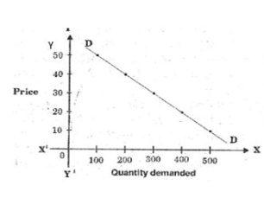
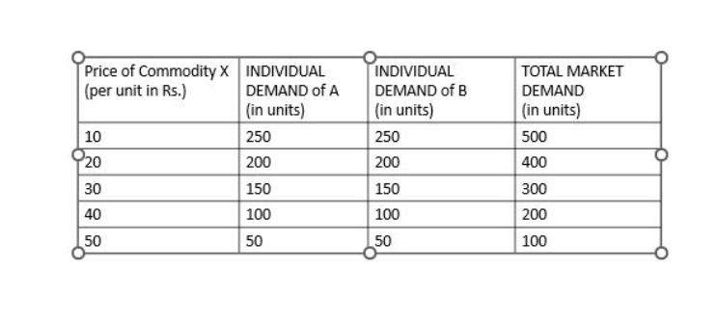
Explanation of the law of demand with the help of market demand schedule and diagram (Curve):

Slide 5

Individual Demand Schedule:
It is a tabular representation of various quantities of a commodity demanded by consumer A at different prices during a given period of time. From the above schedule we observe that at a higher price of Rs.50 per unit of commodity X the demand is low i.e. only for 50 units and at a lower price of Rs.10, the market demand rises to 250 units. This shows a inverse relationship between price and quantity demanded.
Individual Demand Curve:
It is a graphical representation of market demand schedule. Measure price of Y axis and quantity demanded on X axis and plot the schedule on this graph to get the demand curve DD. The demand curve DD slopes downwards from left to right showing a inverse relationship between price and demand. It has a negative slope.

Slide 6

Market Demand Schedule:
It is a tabular representation of various quantities of a commodity demanded by different consumers at different prices during a given period of time. From the above schedule we observe that at a higher price of Rs.50 per unit of commodity X the market demand is low i.e. only for 100 units and at a lower price of Rs.10, the market demand rises to 500 units. This shows a inverse relationship between price and quantity demanded.
Market Demand Curve:
It is a graphical representation of market demand schedule. Measure price of Y axis and quantity demanded on X axis and plot the schedule on this graph to get the demand curve DD. The demand curve DD slopes downwards from left to right showing a inverse relationship between price and demand. It has a negative slope.

Slide 7
ASSIGNMENT 1
Revise the lecture and write down the questions in 100 words
Draw individual demand curve of Consumer A and B
Draw market demand curve

