Slide 1


Elasticity of Demand

Slide 2

ELASTICITY OF DEMAND
The elasticity of demand is the percentage of change in the quantity that is in demand divided by the percentage change in the economic variable.
So, if the price elasticity of demand is being measured, the formula would be the percentage of change in the quantity in demand divided by the percentage change in price.
Price elasticity of demand is a ratio of the responsiveness of consumers to the change in price of the product.
Income elasticity of demand is a ratio of the responsiveness of consumers to the change in income.
Cross elasticity of demand is a ratio of the responsiveness of consumers demand for (B) to the change in price of the product (A).

Slide 3

PRICE ELASTICITY OF DEMAND
ed= %change in quantity demanded
% change in price
Price elasticity of demand is a ratio of the responsiveness of consumers to the change in price of the product.

Slide 4

INCOME ELASTICITY OF DEMAND
ed= %change in quantity demanded
% change in income
Income elasticity of demand is a ratio of the responsiveness of consumers to the change in income.
Elasticity of Demand

Slide 5

CROSS ELASTICITY OF DEMAND
ed= %change in quantity demanded (B)
%change in Price (A)
Cross elasticity of demand is a ratio of the responsiveness of consumers demand for (B) to the change in price of the product (A).

Slide 6
DEGREES OF ELASTICITY OF DEMAND
1. Perfectly Elastic Demand:
Perfectly elastic demand is said to happen when a little change in price leads to an infinite change in quantity demanded. A small rise in price on the part of the seller reduces the demand to zero. In such a case the shape of the demand curve will be horizontal straight line as shown in figure 1.
Perfectly Elastic Demand
The figure 1 shows that at the ruling price OP, the demand is infinite. A slight rise in price will contract the demand to zero. A slight fall in price will attract more consumers but the elasticity of demand will remain infinite (ed=∞). But in real world, the cases of perfectly elastic demand are exceedingly rare and are not of any practical interest.

Slide 7
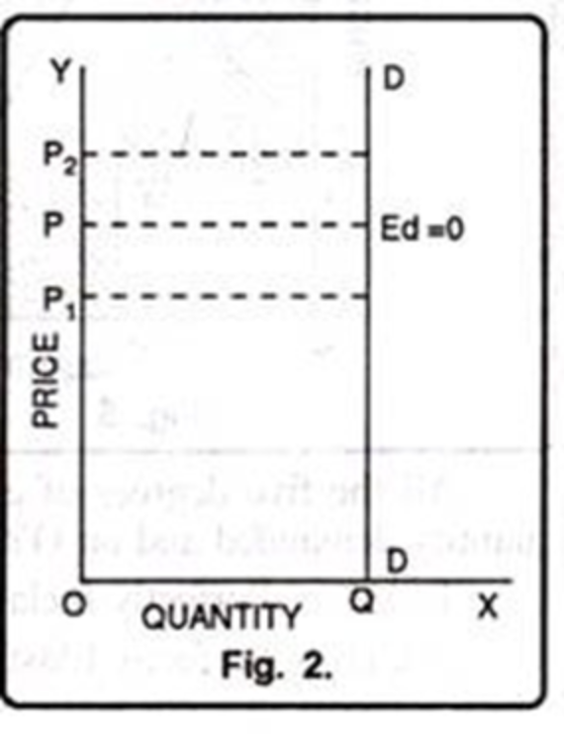
2. Perfectly Inelastic Demand:
Perfectly inelastic demand is opposite to perfectly elastic demand. Under the perfectly inelastic demand, irrespective of any rise or fall in price of a commodity, the quantity demanded remains the same. The elasticity of demand in this case will be equal to zero (ed = 0).
Perfectly Inelastic Demand
In diagram 2 DD shows the perfectly inelastic demand. At price OP, the quantity demanded is OQ. Now, the price falls to OP1, from OP, the demand remains the same. Similarly, if the price rises to OP2 the demand still remains the same. But just as we do not see the example of perfectly elastic demand in the real world, in the same fashion, it is difficult to come across the cases of perfectly inelastic demand because even the demand for, bare essentials of life does show some degree of responsiveness to change in price.

Slide 8
3. Unitary Elastic Demand:
The demand is said to be unitary elastic when a given proportionate change in the price level brings about an equal proportionate change in quantity demanded. The numerical value of unitary elastic demand is exactly one i.e. Marshall calls it unit elastic.
In figure 3, DD demand curve represents unitary elastic demand. This demand curve is called rectangular hyperbola. When price is OP, the quantity demanded is OQ\. Now price falls to OP1 the quantity demanded increases to OQ2. The area OQ\RP = area OP\SQ2 in the fig. denotes that in all cases price elasticity of demand is equal to one.

Slide 9
4. Elasticity more than one:
Relatively elastic demand refers to a situation in which a small change in price leads to a big change in quantity demanded. In such a case elasticity of demand is said to be more than one (ed > 1). This has been shown in figure 4.
In fig. 4, DD is the demand curve which indicates that when price is OP the quantity demanded is OQ1. Now the price falls from OP to OP1, the quantity demanded increases from OQ1 to OQ2 i.e. quantity demanded changes more than change in price.’

Slide 10
5. Elasticity less than one
Under the relatively inelastic demand, a given percentage change in price produces a relatively less percentage change in quantity demanded. In such a case elasticity of demand is said to be less than one (ed < 1). It has been shown in figure 5.
All the five degrees of elasticity of demand have been shown in figure 6. On OX axis, quantity demanded and on OY axis price is given.

