Slide 1
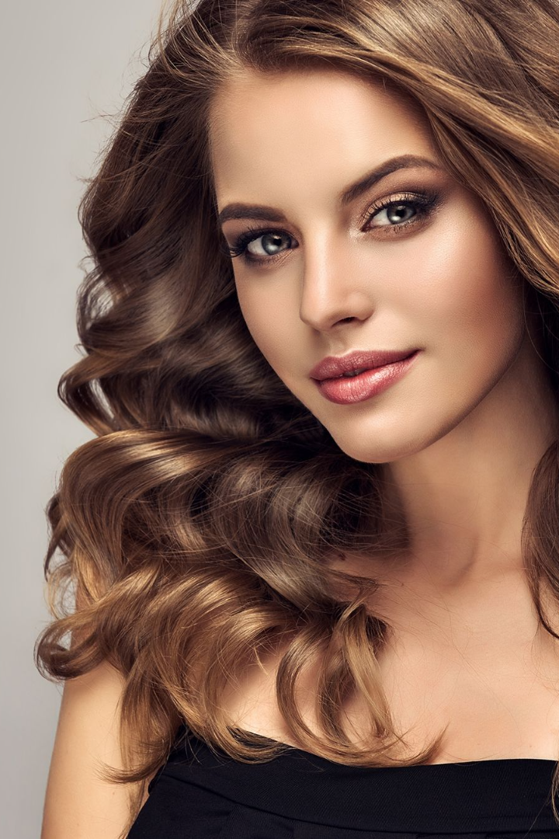


Hair Anatomy
Welcome to our hair anatomy presentation. Join us as we dive into the fascinating world of hair!
by simran kaur

Slide 2

Hair Composition
1
Keratin 🧬
2
Structure 🔍
Hair is made up of a protein called keratin.
Keratin molecules form long chains that are held together by disulfide bonds, giving hair its strength and structure.
3
Water 💦
Hair also contains water, lipids, and pigments that give it its color.

Slide 3
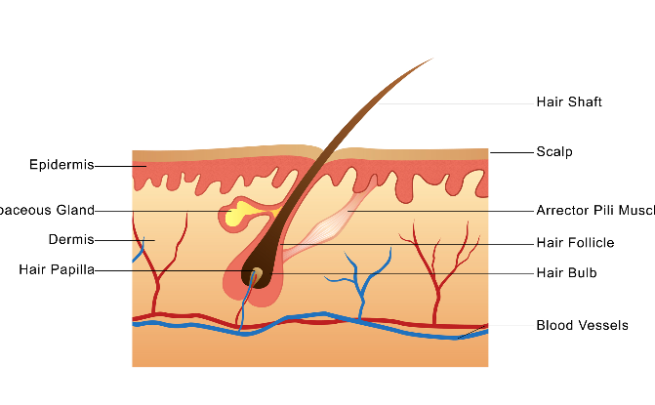
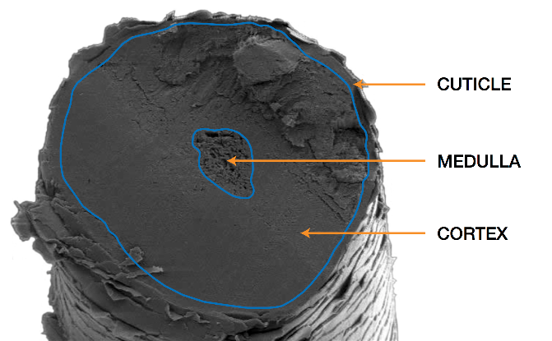
Hair Follicle Structure
Roots 🌱
Structure 🔍
Hair grows from follicles embedded deep in the skin.
Hair has three layers: the cuticle, cortex, and medulla. Each layer plays a different role in protecting and maintaining hair.

Slide 4
Hair Growth Cycle
1
Anagen
The growth phase where hair actively grows, typically lasts 2-7 years.
Catagen
2
The transitional phase where hair stops growing and separates from the follicle, lasts about 2-3 weeks.
3
Telogen
The resting phase where the old hair falls out and new hair begins to grow, lasts about 3-4 months.

Slide 5
Types of Hair
Straight
Wavy
Straight hair is naturally smooth and shiny.
Wavy hair has loose, natural waves that add volume and texture.
Curly
Coily
Curly hair has tight curls that can range in size from small ringlets to loose spirals.
Coily hair has tight, springy curls that are often prone to dryness.

Slide 6
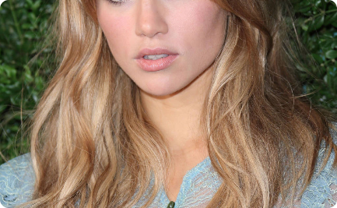
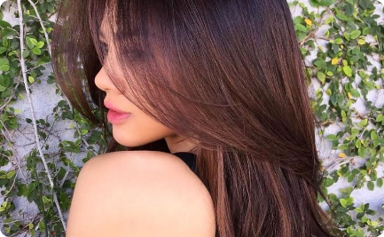
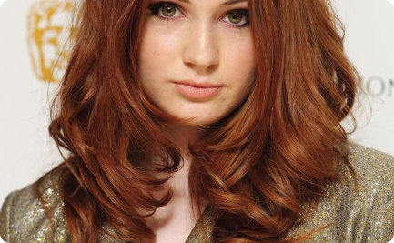
Hair Color
Blonde
Brunette
Red
Blonde hair is the lightest shade of hair, ranging from pale yellow to platinum.
Brunette hair is any shade of hair that’s brown, ranging from light to dark.
Red hair has an orange or coppery tint, and ranges from ginger to auburn.

Slide 7
Common Hair Problems
Dandruff
Hair Loss
Split Ends
Dandruff is a common scalp condition that causes flaky skin and itching. It can be treated with medicated shampoos and a healthy hair care routine.
Hair loss can be caused by genetics, hormonal changes, or stress. Treatments include medication, hair transplants, and lifestyle changes.
Split ends occur when the ends of hair become dry and brittle. Trimming the ends regularly and using conditioner can help prevent split ends.

Slide 8
Hair Care Tips
1
Shampooing
On average, hair should be washed every 2-3 days.
Conditioning
2
Use conditioner to keep hair soft and shiny, paying special attention to the ends.
3
Heat Styling
Use a heat protectant when styling with hot tools to prevent damage.
Diet
4
Eating a healthy diet that’s rich in protein, vitamins, and minerals can help keep hair healthy.
5
Hydration
Drinking plenty of water can help keep hair hydrated and healthy.
Protective Styles
6
Avoid styles that pull at the hair, and consider protective styles like braids or a turban to keep hair healthy.

