Slide 1

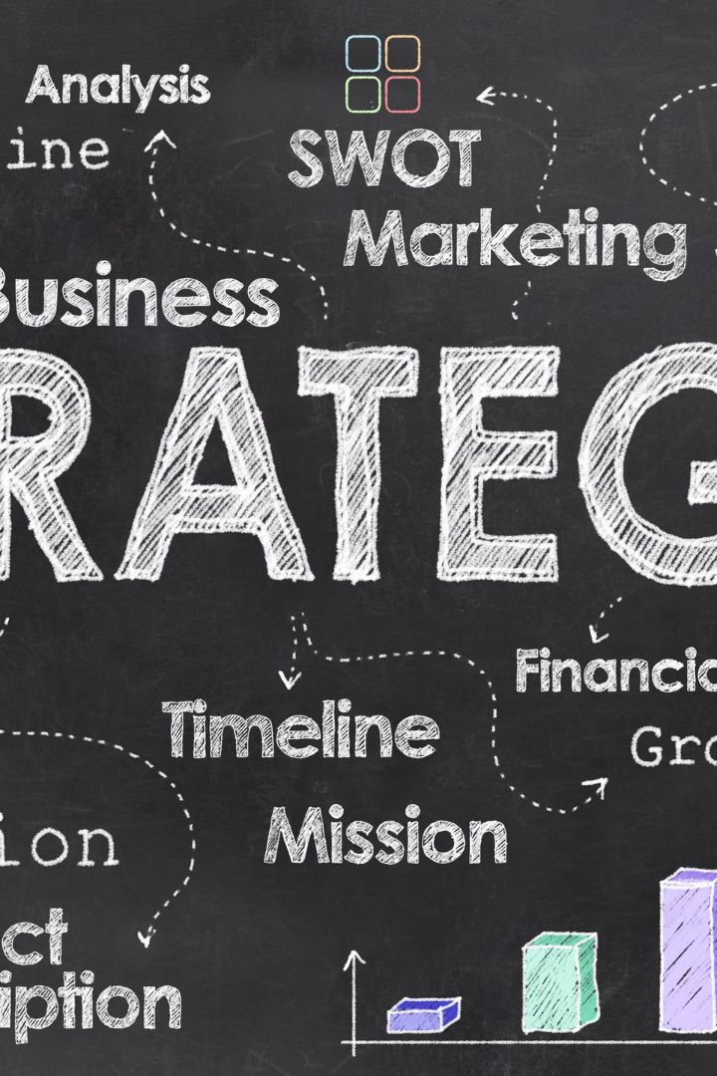


Porter Model
An overview of the Porter Model, a framework used to analyze the competitive forces in an industry and develop business strategies for success.
by Dr.Hardeep Kaur

Slide 2

Key Concepts
1
Five Forces Analysis
Analyze the competitive forces that shape an industry, including the power of buyers and suppliers, the threat of new entrants, the threat of substitutes, and the intensity of competition.
2
Competitive Advantage
Develop a unique position in the market to outperform competitors and achieve higher profit margins by offering superior value to customers.

Slide 3

Application in Business Strategy
1
Strategic Positioning
2
Industry Analysis
3
Value Chain Analysis
Identify and choose a clear position in the market that aligns with a company's strengths and provides a competitive advantage.
Evaluate the overall industry structure, including market trends, customer needs, and the competitive landscape, to inform strategic decision-making.
Analyze the activities and processes within a company to identify areas of competitive advantage and opportunities for cost reduction or differentiation.

Slide 4
Benefits and Limitations
Benefits
Limitations
Clear understanding of industry dynamics
Doesn't account for rapid technological changes
Identification of competitive threats and opportunities
Relies on accurate and reliable data
May oversimplify complex business environments
Focused strategic decision-making

Slide 5



Real-World Examples
Coca-Cola
Apple
McDonald's
Uses Porter Model to continuously assess competition, innovate products, and maintain a strong market position.
Applies Porter Model to differentiate its products, create customer value, and establish itself as a leader in the tech industry.
Utilizes Porter Model to maintain a competitive edge in the fast-food industry and drive growth through strategic positioning.

Slide 6
Conclusion
1
Key Takeaways
2
Continued Relevance
Porter Model provides a structured approach to understand industry dynamics, develop competitive strategies, and achieve sustainable business success.
Despite limitations, Porter Model remains a cornerstone for businesses seeking to navigate competitive landscapes and find strategic advantages.

