Slide 1


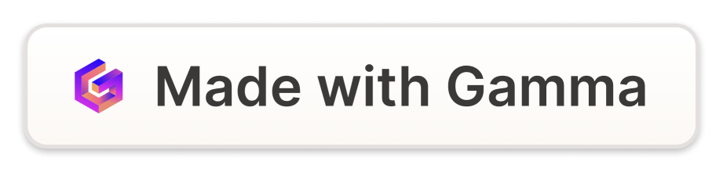
The Power of Management Control Systems
A management control system is the backbone of any organization. It enables businesses to monitor and manage their operations effectively, providing a solid foundation for growth and success.
by neha bathla

Slide 2

The Definition of Management Control System
1
Control
2
Management
3
System
The process that ensures that resources are used efficiently and effectively to achieve organizational goals.
The coordination of all the activities to meet organizational objectives by planning, organizing, directing, and controlling.
A set of interrelated elements that work together to achieve a common goal.

Slide 3



The Importance of Implementing a Management Control System
Efficiency
Growth
Control
Prevents disorganization and chaos in operations, which leads to more streamlined processes and increased productivity.
Provides a roadmap for business growth and expansion, allowing for scalability and long-term success.
Enforces discipline and control over key business functions to ensure that the organization is moving in the right direction with the right priorities.

Slide 4
Components of a Management Control System
1
Strategic Planning
Development of long-term business plans that lay out clear objectives and goals.
Budgeting and Forecasting
2
Preparation of financial budgets based on expected demand, revenue, and expenses helps in identifying deviations and taking corrective measures.
3
Performance Monitoring & Reporting
Monitoring and reporting of progress against objectives and evaluating performance against benchmarks.
Risk Management
4
Identifying, assessing, and managing key business risks to ensure that the organization maintains adequate insurance and contingency plans.

Slide 5
Different Types of Management Control Systems
Bureaucratic
Normative
The use of authority, hierarchy, and rules to implement control mechanisms.
The use of organizational culture, values, and beliefs to implement control mechanisms.
Objective
Concertive
The use of performance measures and feedback systems to implement control mechanisms.
The use of shared values and goals as well as norms of cooperation to implement control mechanisms.

Slide 6

Benefits of a Well-Designed Management Control System
1
Improved Decision Making
Empirical data helps in making informed decisions.
Efficient Resource Allocation
2
Allocation of resources based on realistic budgets and forecasts.
3
Operational Effectiveness
Streamlined operations with a well-understood hierarchy of responsibility.

Slide 7



Challenges Faced in Implementing a Management Control System
Resistance to Change
Time Constraints
Cultural Diversity
Employees may resist the implementation of new organizational structures, processes, and systems.
Time constraints and lack of resources may be a hindrance to the implementation of new control systems.
Organizational culture may vary based on different business entities and location.

Slide 8
Best Practices for Effective Management Control Systems Implementation
Clear Objectives
Effective Communication
Employee Engagement
The desired end goals for the business should be clearly defined.
Effective communication channels need to be in place for everyone to be aware of control systems implementation.
Employee opinions should be taken into consideration to ensure a smoother adaptation process.

