Slide 1
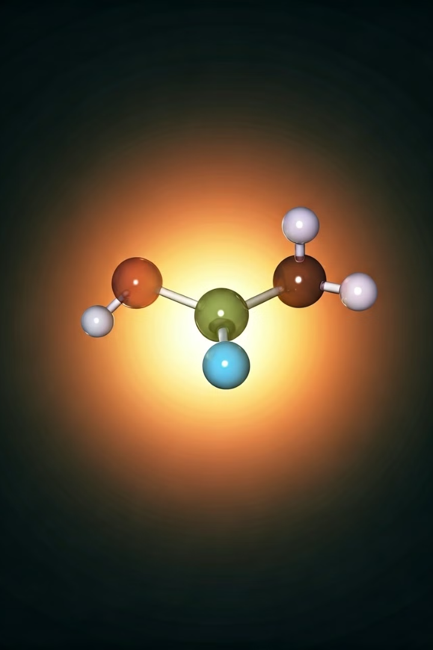

Introduction to Carbanions
Carbanions are carbon-based anions with a negatively charged carbon atom. They are highly reactive species that play a crucial role in organic chemistry, particularly in synthesis and reaction mechanisms.
by Aman

Slide 2
Definition and Structure
Definition
Structure
Bonding
A carbanion is a negatively charged carbon atom with three substituents. It is a type of nucleophile, capable of donating a pair of electrons to electrophilic species.
The carbon atom in a carbanion has a trigonal planar geometry, with the negative charge delocalized across the substituents. This configuration provides stability and reactivity.
The carbon-carbon bonds in a carbanion are typically sp2-hybridized, allowing for resonance stabilization and varying degrees of electrophilic character.

Slide 3
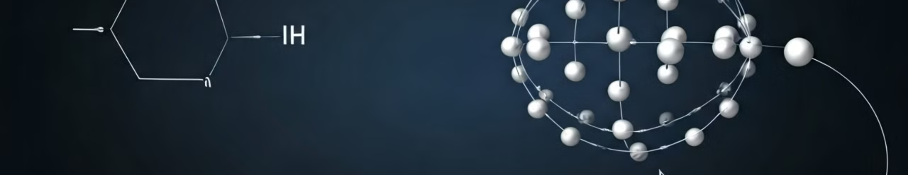
Stability and Reactivity
1
Stability Factors
2
Reactivity
3
Kinetic vs. Thermodynamic
Carbanions are stabilized by factors such as conjugation, hyperconjugation, and the presence of electronegative substituents.
Carbanions are highly reactive and can participate in various organic reactions, including nucleophilic additions, substitutions, and rearrangements.
The stability and reactivity of carbanions can be influenced by kinetic and thermodynamic factors, resulting in different reaction pathways and products.

Slide 4





Generation of Carbanions
Deprotonation
Reduction
Elimination
Rearrangements
Carbanions can be generated through the deprotonation of organic compounds using strong bases, such as alkyllithiums or Grignard reagents.
Carbanions can also be produced by the reduction of carbonyl compounds, halides, or other electrophilic species using reducing agents.
Carbanions can be formed through the elimination of leaving groups, such as halides or sulfonates, from organic precursors.
Certain organic rearrangements, like the Favorskii reaction, can also lead to the formation of carbanion intermediates.

Slide 5
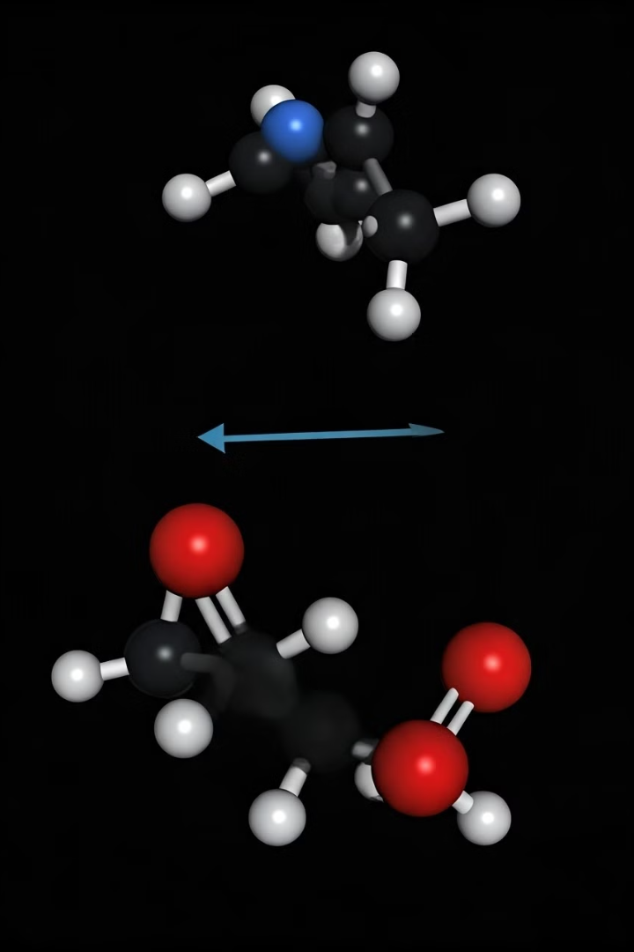



Nucleophilic Substitution Reactions
SN2 Mechanism
Carbanions can act as nucleophiles in substitution reactions, such as the SN2 mechanism, where they attack electrophilic carbon centers.
Stereochemistry
SN2 reactions with carbanions typically result in the inversion of stereochemistry at the substituted carbon atom.
Competing Pathways
The reactivity of carbanions in substitution reactions can be influenced by steric factors, leaving group ability, and the presence of other reactive functional groups.

Slide 6
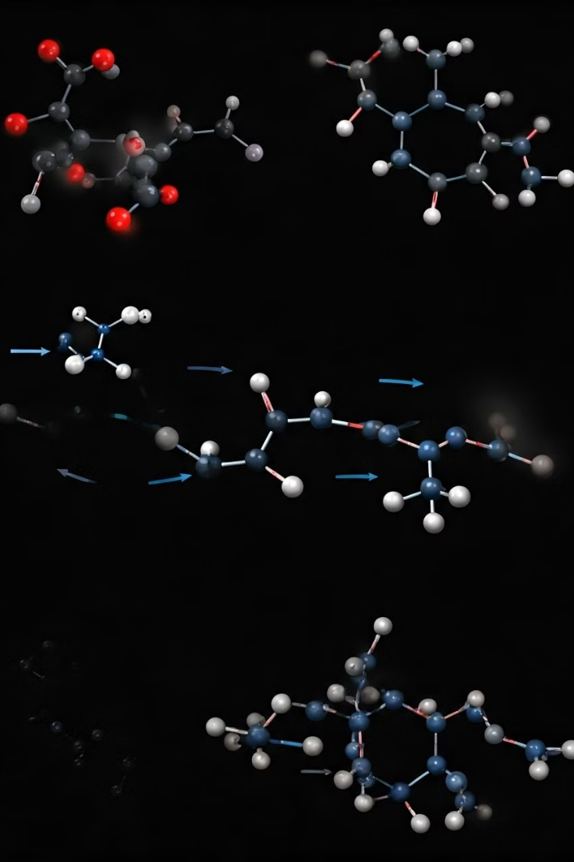
Carbanion Rearrangements
1
1,2-Sigmatropic Shifts
Carbanions can undergo 1,2-sigmatropic shifts, such as the Favorskii rearrangement, leading to the formation of new carbon-carbon bonds.
2
Fragmentation
Carbanions can also undergo fragmentation reactions, where they split into smaller fragments, often generating other reactive species.
3
Pinacol Rearrangement
The pinacol rearrangement is a classic example of a carbanion-mediated rearrangement, forming new carbon-carbon bonds.

Slide 7
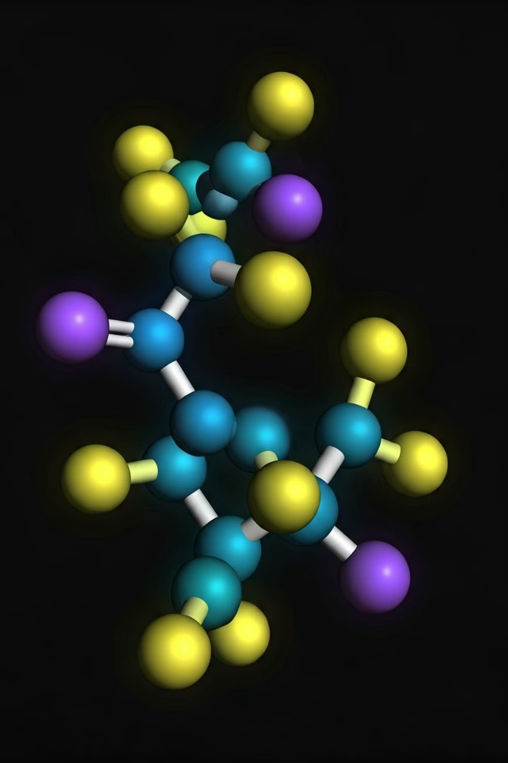
Carbanion Stabilization Techniques
Conjugation
Hyperconjugation
Carbanions can be stabilized through conjugation with aromatic rings or other unsaturated functional groups.
The overlap of a carbanion's empty p-orbital with adjacent C-H bonds can provide stabilization through hyperconjugation.
Chelation
Solvation
Coordination of a carbanion to a metal cation, such as in organometallic compounds, can enhance its stability.
The choice of solvent can affect the solvation and stability of carbanions, with polar aprotic solvents often favoring their formation.

Slide 8
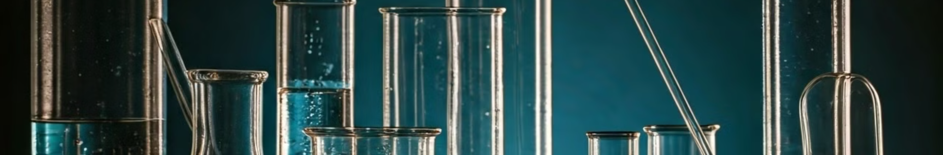
Synthetic Applications of Carbanions
Carbon-Carbon Bond Formation
Carbanions can be employed in various coupling reactions, such as the Grignard reaction and the Aldol condensation, to form new C-C bonds.
Alkylation and Acylation
Carbanions can act as nucleophiles in alkylation and acylation reactions, introducing alkyl or acyl groups to organic substrates.
Reduction and Homologation
Carbanions can be used in reduction reactions, such as the Wolff-Kishner reduction, and in homologation reactions to extend carbon chains.
Anionic Cyclization
Carbanion-mediated cyclization reactions, like the Dieckmann condensation, can be used to construct cyclic organic compounds.

Slide 9
Biological Relevance of Carbanions
Enzymatic Reactions
Metabolic Pathways
Pharmaceutical Applications
Carbanions can be involved as intermediates in various enzymatic transformations, such as decarboxylation and retro-aldol reactions.
Carbanion species play a role in certain metabolic pathways, including the biosynthesis of lipids, amino acids, and secondary metabolites.
Understanding the reactivity and stability of carbanions is crucial in the design and development of pharmaceuticals, as they can be involved in drug metabolism and action.

Slide 10
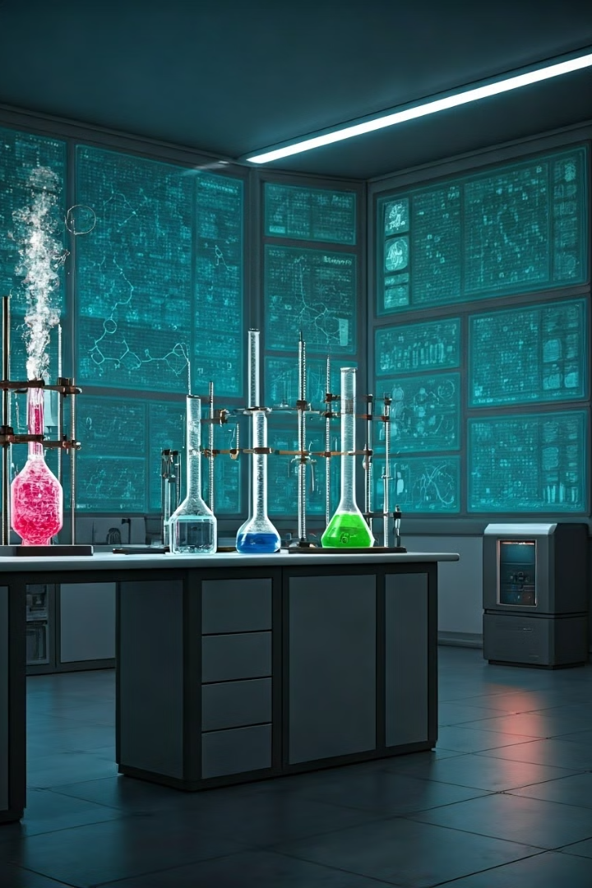
Conclusion and Future Perspectives
1
Significance of Carbanions
2
Ongoing Research
Ongoing research aims to further understand the stability, reactivity, and novel applications of carbanions in various fields, including organic synthesis and chemical biology.
Carbanions are fundamental reactive intermediates in organic chemistry, with a wide range of synthetic and biological applications.
3
Future Outlook
The continued exploration of carbanion chemistry will lead to the development of more efficient and selective synthetic methodologies, as well as the discovery of new biological processes involving these reactive species.

