Slide 1



Location of Industry
Explore the importance of location in the industrial sector. Discover the factors influencing industry location decisions and the advantages and disadvantages of different locations.
by Dr.Hardeep Kaur

Slide 2

Factors Influencing Industry Location
Proximity to raw materials
Access to transportation networks
Availability of skilled labor
Market demand and target audience

Slide 3
Advantages and Disadvantages of Different Locations
Urban Areas
Rural Areas
Coastal Areas
Pros: Access to a large consumer market and skilled workforce.
Pros: Lower costs, ample space, and potential for tax incentives.
Pros: Access to ports, shipping routes, and trade opportunities.
Cons: Higher costs, competition, and congestion.
Cons: Limited access to resources and skilled labor.
Cons: Vulnerability to natural disasters and higher insurance costs.

Slide 4

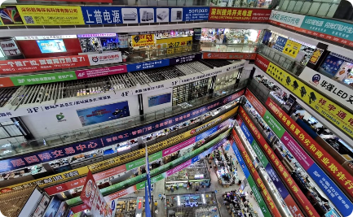
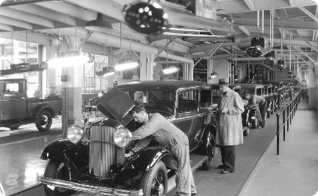
Case Studies of Successful Industry Locations
Silicon Valley, USA
Shenzhen, China
Detroit, USA
Discover how the combination of renowned universities, venture capital, and a collaborative culture led to the rise of the world's leading tech hub.
Learn about the transformation of a small fishing village into a global manufacturing and technology center, specializing in electronics.
Explore the history and decline of the Detroit automobile industry, once the heart of American manufacturing.

Slide 5
Trends in Industry Relocation
1
Offshoring and Globalization
Discover how the outsourcing of manufacturing and services to countries with lower costs has reshaped the global industrial landscape.
Reshoring and Nearshoring
2
Learn about the recent trend of bringing manufacturing operations back to the home country or to nearby locations due to rising costs and trade uncertainties.
3
Smart Factories and Automation
Explore the adoption of advanced technologies, such as robotics and artificial intelligence, which are transforming traditional factories into intelligent and efficient production centers.

Slide 6

Government Policies and Incentives
1
Tax Breaks and Financial Incentives
2
Special Economic Zones
Learn about the strategies governments use to attract industries, including offering tax breaks, grants, subsidies, and infrastructure development.
Discover how governments create designated areas with special regulations and incentives to attract industries and promote economic growth.
3
Training and Skill Development Programs
Explore government initiatives aimed at developing a skilled workforce to meet the needs of industries in specific locations.

Slide 7

Conclusion and Key Takeaways
Summarize the key points discussed throughout the presentation, emphasizing the importance of location in industry and the influence of various factors on location decisions.

