Slide 1

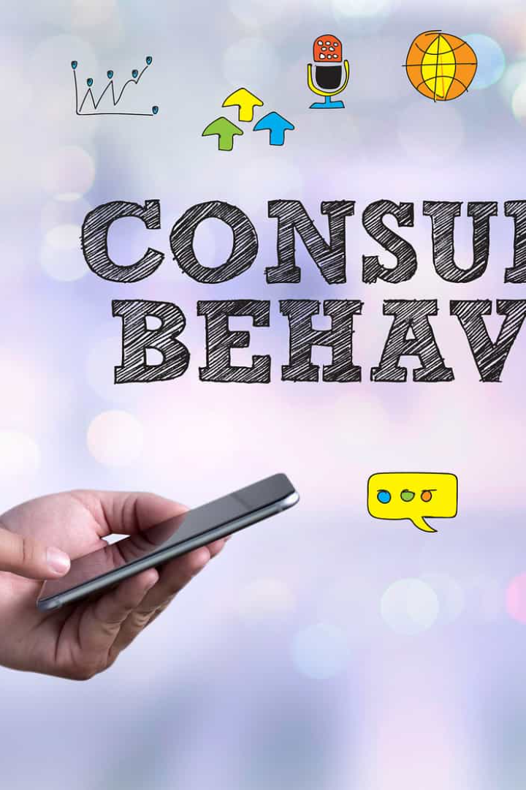

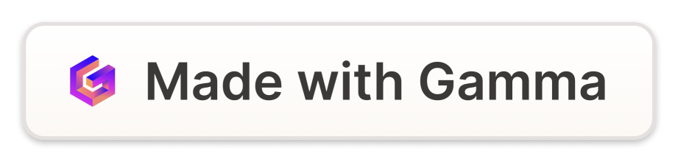
Consumer Behaviour
Understanding the complex factors that shape consumer behavior is crucial for businesses. Let's explore the key elements that influence how consumers make decisions.
by neha bathla

Slide 2


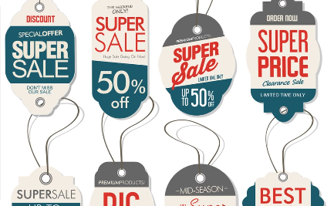
Factors Influencing Consumer Behavior
Culture
Social Environment
Price
Cultural values, beliefs, and norms significantly impact consumer preferences and behaviors.
Social influences such as family, friends, and reference groups shape consumer choices.
Consumer decisions are influenced by pricing strategies, discounts, and perceived value.

Slide 3
Consumer Decision-Making Process
Need Recognition
Information Search
Consumers identify a need or want that prompts the decision-making process.
Consumers seek information about available options to evaluate alternatives.
Evaluation of Alternatives
Purchase Decision
Consumers compare and analyze different products to make the best choice.
The decision to buy a specific product or service is made based on evaluation.

Slide 4

Types of Consumer Buying Behavior
1
Complex Behavior
Consumers engage in extensive research and evaluation before making a purchase.
2
Dissonance-Reducing Behavior
Consumers experience post-purchase doubts but seek reassurance to reduce cognitive dissonance.
3
Habitual Behavior
Consumers make regular purchases with minimal thought or effort.

Slide 5

Motives and Needs Driving Consumer Behavior
1
Psychological Needs
2
Functional Needs
3
Social Needs
Consumers are motivated by desires for safety, love, self-esteem, and self-actualization.
Consumers seek products that fulfill a specific practical purpose or solve a problem.
Consumers are influenced by the need for acceptance, belonging, and social status.

Slide 6
Effects of Culture, Social Class, and Reference Groups
Culture
Social Class
Reference Groups
The cultural background of an individual shapes their values, customs, and buying preferences.
Social class influences consumer behavior and the brands individuals gravitate towards.
Consumer choices are affected by the opinions, recommendations, and behaviors of reference groups.

Slide 7

Marketing Strategies to Influence Consumer Behavior
1
Segmentation
Identify and target specific consumer segments for tailored marketing strategies.
2
Advertising & Promotion
Create compelling messages and campaigns to influence consumer perceptions and decisions.
3
Product Positioning
Develop unique product offerings that differentiate from competitors and appeal to target audiences.

Slide 8
Future Trends in Consumer Behavior
Personalization
Consumers will expect personalized experiences and offerings tailored to their unique preferences.
Technology Adoption
Innovations like AI, AR, and voice assistants will continue to shape consumer interactions with brands.
Social Responsibility
Consumers will prioritize brands that demonstrate social and environmental responsibility.

